Slide 1

Developing Data Sharing Arrangements between EHDI and Part C to Improve Early Identification and Services
Haidee Bernstein, Karl White,
Evelyn Shaw, Sharon Walsh
Find your name in the participant’s list. Please click on the "More" button by your name to "Rename". Add your name, state, program
Sign in by finding your name on the participant list. Please add your affiliation.
21st Annual Early Hearing Detection & Intervention Conference
March 13–15, 2022

Slide 2
Welcome
Who we are:
Karl White: Director, NCHAM
Evelyn Shaw Foard: Technical Assistance Specialist, ECTA
Haidee Bernstein: Early Childhood Researcher/Specialist, DaSy
Sharon Walsh: Consultant, ECTA and DaSy

Slide 3
State Participants
Wisconsin
Elizabeth Seeliger, AuD, IMH-E Program Director, Wisconsin Sound Beginnings
Lori Wittemann, Children and Family Program Specialist--WI Birth to 3 Program, Special Education Coordinator--DHS School District, Bureau of Children’s Services, Dept. of Health Services
Christine Kometer, M.Ed, LSLS Cert AVEd, Early Intervention Coordinator, CESA #1 Wisconsin Sound Beginnings
Michigan
Colleen O’Connor, Early On Consultant, Office of Great Start/Early Childhood Development and Family Education, Michigan Dept of Education
Michelle Garcia, Au.D., CCC-A Follow-Up Consultant, Early Hearing Detection and Intervention Program

Slide 4

Logistics
We are a large group, please stay muted if you are not speaking.
We do want to hear from you, so please use the Chat. Questions and Comments are encouraged.
We have some Q & A time built in. During that time, please unmute and share your thoughts and ideas.
We are a 3-hour session, so we have built in a two 10-minute breaks.

Slide 5
Poll 1
What is your current role?
  EHDI Coordinator or other EDHI state office staff
  Part C Coordinator or other Part C state staff
  State Schools for the Deaf and/or Deaf/Blind
  Federal Agency Staff
  Family members
  Family-based organization staff
  Researcher
  Direct Service Providers
  Other

Slide 6
Polls 2 and 3
How familiar are you with the requirements and practices related to data sharing?
  not familiar
  somewhat familiar
  very familiar
  can do it in my sleep
To what extent are you currently sharing data between EHDI and Part C?
  Not at all
  Planning but not yet sharing
  Recently began sharing
  Been sharing for a while.
  Not sure

Slide 7

We Have 3 Gifts for You
We will reveal them throughout the session!

Slide 8
Intended Outcomes
Participants will:
Increase their understanding of the privacy requirements (e.g., under IDEA, FERPA and HIPAA) and important technical aspects needed to address data sharing.
Gain knowledge of data sharing arrangements including challenges and strategies from selected states
Share and receive resources about data sharing
Network with other participants and presenters to discuss current state activities and plans for updating or developing data sharing arrangements among EHDI, Part C, and others

Slide 9

AGENDA
Introductions/Icebreaker
Gift 1
Privacy and Confidentiality Discussion
Break
Addressing Data Sharing: Privacy regulations/requirements
Gift 2
State presentations: Michigan and Wisconsin
Stretch Break
Gift 3
Share Website and other Resources
Wrap-up, next steps, getting your TA needs met

Slide 10

Ice Breaker
Please enter in the chat:
  What has been the most successful moment in your data sharing work?
  What has been the biggest challenge you have faced in data sharing?

Slide 11
Ready for Your First Gift?
https://ectacenter.org/topics/earlyid/ehdidata.asp​

Slide 12
Requirements
IDEA, FERPA, HIPAA Requirements
Related to Data Sharing Arrangements

Slide 13
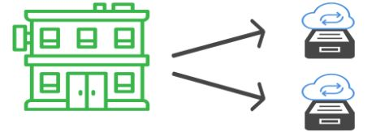
Consider Two Scenarios
Scenario A
Single lead agency, Health Department, two separate data systems for Part C and EHDI
Scenario B
Two different lead agencies, Health for EHDI and Non-Health for Part C, each has its own data system

Slide 14
Three Main Privacy Laws
Part C Regulations
IDEA (Individuals with Disabilities Education Act)
  Birth to 3 early intervention population
Family Educational Rights and Privacy Act (FERPA)
Entities receiving U.S. Department of Education Funds
Confidentiality of “education records”
Health Insurance Portability and Accountability Act (HIPAA)
Title II, Privacy Rule
Use of Protected Health Information by covered entities

Slide 15
Part C Privacy Regulations
Signed consent IS required for Part C to share any personal information with “non-participating entities” (i.e., entities outside the Part C system who contribute substantially to multiple components of the system --- not just to Child Find)
Signed consent IS NOT needed for anyone to refer a child to Part C (name, contact info, reason for referral)
Signed consent IS NOT needed for Part C to share info with “participating entities”
Part C is more restrictive than either HIPAA or FERPA

Slide 16
IDEA Part C Participating Agency
PII data can only be shared outside of participating agencies with parental consent
Any individual, agency, entity, or institution that collects, maintains, or uses personally identifiable information to implement the requirements in Part C.
Includes LA, EIPs, and any individual/entity that provides any part C services.
Does not include primary referral sources or public agencies or private entities that act solely as funding sources for Part C services.
All participating agencies (including the lead agency and EIS providers) must comply with the Part C confidentiality procedures

Slide 17
When Do Requirements Apply Under Part C?
Confidentiality procedures apply to the personally identifiable information (PII) of a child/family that:
Are contained in early intervention records collected, used, or maintained under Part C by the lead agency or an EIS provider; and
Apply from the point in time when the child is referred for early intervention services under Part C until the later of when the participating agency is no longer required to maintain or no longer maintains that information under applicable Federal and State laws.
You can always release data with parental consent or
if the data are properly de-identified data (no PII)

Slide 18
Disclosure of PII Under FERPA Without Consent
FERPA permits disclosure of PII without parental consent under several exceptions including:
To authorized representatives of federal, state, and local educational authorities conducting an audit, evaluation, or enforcement of education programs;
To school officials with legitimate educational interests (defined in annual notification);
  Staff or employees who need access to perform duties
    School official exception
    “Legitimate educational interest”
  External entities
    Studies exception
    Audit or evaluation exception
    Uninterrupted Scholars Act
    Other (e.g., court order, health or safety emergency)

Slide 19
What Is Required in a Data Sharing Agreement?
Can be called different names: MOU, MOA, Contract, Written Agreement, etc.
Must include:
  Designation of individual or entity as an authorized representative;
  The PII from education records to be disclosed;
  The purpose for which the PII is disclosed for an audit or evaluation of Federal or State supported education programs, or to comply with Federal requirements;
  A description of the activity with sufficient specificity to be clear the work falls within the exception, including a description of how the PII will be used;

Slide 20
What Is Needed in a Data Sharing Agreement?
Require the authorized representative to destroy PII when the information is no longer needed for the purpose specified;
Specify the time period in which the information must be destroyed; and
Establish policies and procedures, to protect PII from further disclosure (except back to the disclosing entity) and unauthorized use, including limiting use of PII to only authorized representatives with legitimate interests in the audit or evaluation.

Slide 21
What is HIPAA?
Health Industry Paying All Attorneys
Highly Intricate Paperwork in Abundant Amounts
High Income Potential for Aggressive Attorneys
Huge Increase in Paperwork and Aggravation Act

Slide 22
HIPAA
Covered entity: A health plan, clearinghouse, or health care provider who conducts financial and administrative transactions electronically ( i.e., bills for provision of services)
Protected Health Information (PHI): Individually identifiable health information transmitted or maintained by covered entities
Sharing information
  Signed consent required to use PHI for marketing or research
  Signed consent is NOT required:
    For health providers to exchange information for treatment, payment, health care operations.
    To share information for Public Health purposes
  Providers must keep a record of information that is shared

Slide 23
State laws, regulations, and practices:
  Can provide MORE privacy protections, but not less (i.e., state laws seldom, if ever, enable sharing of education and health related information that is not already allowed under HIPAA, FERPA and/or Part C)
  Can encourage (or discourage) reporting

Slide 24
Impact of Federal Privacy Regulations on:
Hearing Screening
Diagnostic Evaluations
Early Intervention
Linkages with Medical Home and other health care providers
Family Support programs

Slide 25
Federal Privacy Regulations Related to:
Hearing Screening
HIPAA
  Written consent NOT needed for hospitals and/or health care providers to share hearing screening information with EHDI programs, other health care providers and/or Part C, because screening information:
    Is needed for public health activities (e.g., surveillance, program improvement, etc)
    Is needed for facilitating ongoing health care
  Documentation required whenever information is shared
FERPA
  Does not apply until children are enrolled in programs that receive federal education funding.
Part C Privacy Regulations
  Does not apply until children are referred to Part C
  Once children are referred to Part C, any information possessed by the Part C cannot be shared with non-participating entities without written consent
Notes:
Karl

Slide 26
Federal Privacy Regulations Related to: Diagnostic Evaluations
HIPAA
  Written consent NOT needed for health care providers to share Dx info with EHDI programs, other health care providers, and/or Part C, because such information:
    Is needed for public health activities
    Is needed for facilitating ongoing health care
FERPA
  Written consent required for education agencies to share individual Dx info with non-participating entities (except for “honor roll” exception).
Part C Privacy Regulations
  Written consent required to share individual Dx info with non-participating entities
Notes:
Karl

Slide 27
Recommended Strategies
Well informed families who are given own copies of consents and medical/educational records to share as needed
Coordinated consent forms (and training) so that a single signature gives permission to share info with various of providers.
  Ideally, consent would be obtained when child does not pass newborn hearing screening
Memoranda of Agreement (MOA’s) among EHDI, Part C, Family Support Programs and others
Designation of “participating entities ” as part of Part C system.
  Inclusion in Part C State plan
  Memoranda of Agreement and inclusion in Part C State Plan
  Clear responsibility for significant role in MULTIPLE components of Part C system (not just a “child find” provider)
Notes:
Karl

Slide 28
Recommended Strategies (continued)
State laws that require reporting do not remove Federal privacy protections but may encourage better reporting
As part of IFSP/IEP document, obtain written permission from parents to share information with relevant agencies
Integrate computer-based public health information systems (e.g., immunization, blood-spot screening, hearing screening) and include info about services provided to children with special health care needs
Notes:
Karl

Slide 29


Break

Slide 30
Ready for Your Second Gift?
Check Your Handouts

Slide 31
State Presentations
Michigan
Wisconsin

Slide 32
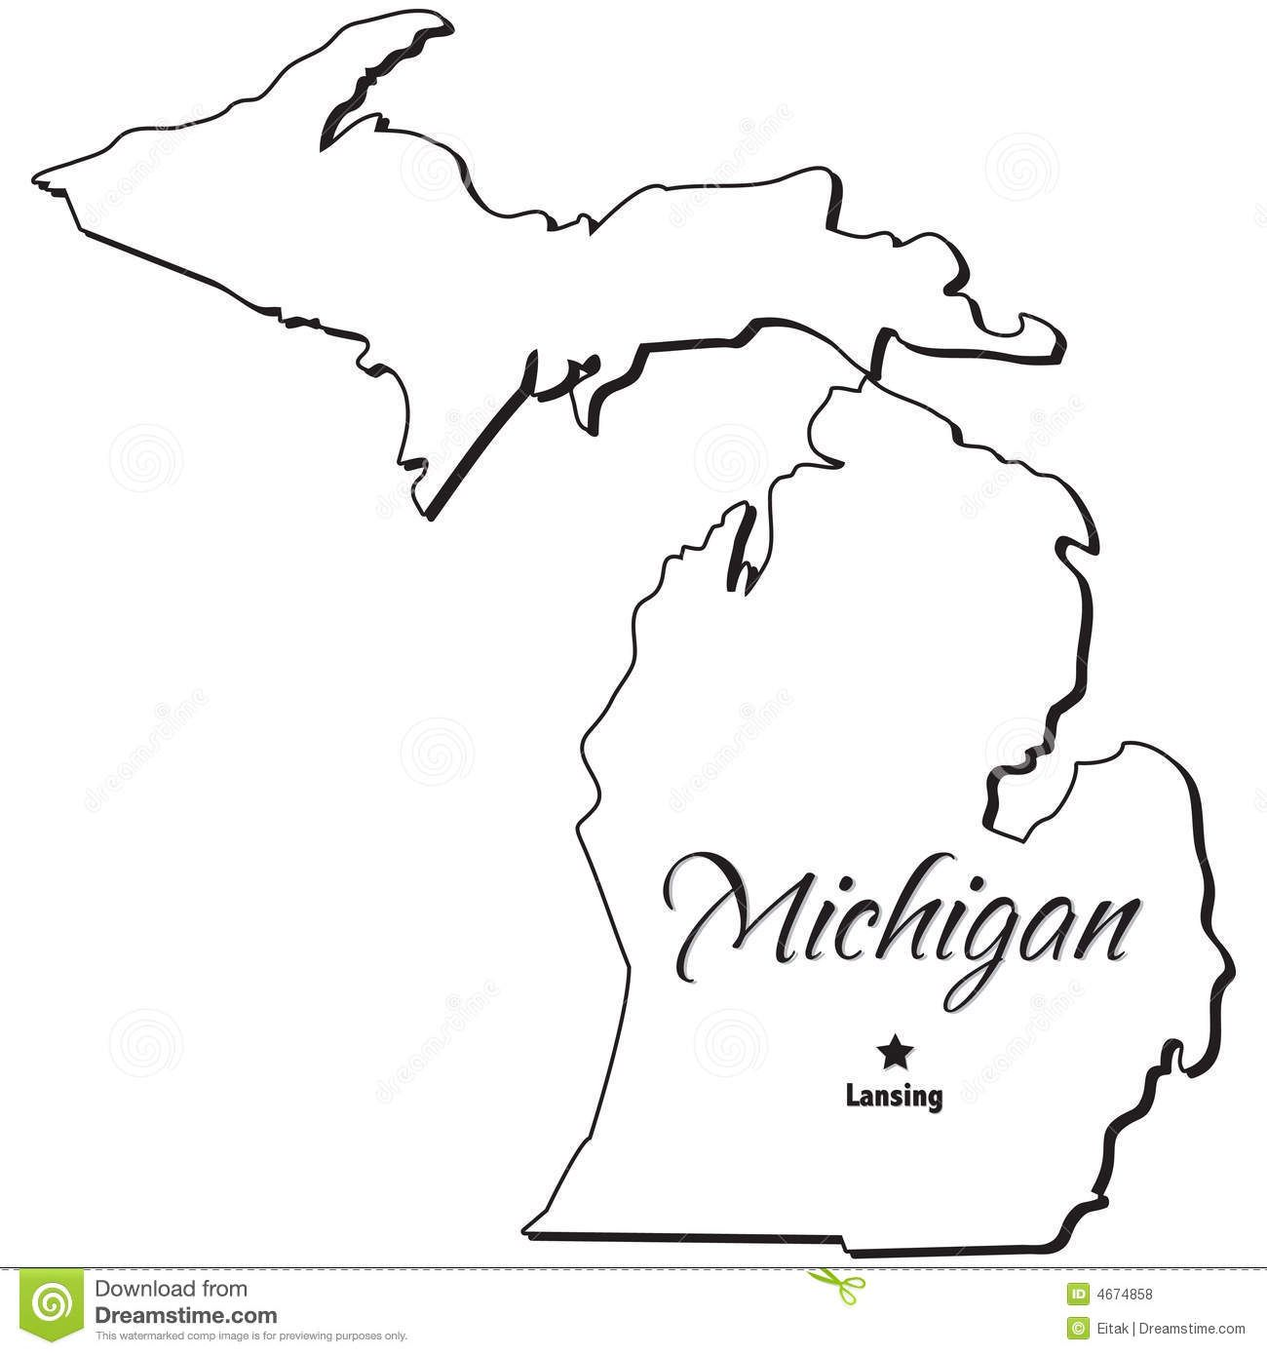
State Data Sharing Examples
Colleen O’Connor, Early On Consultant
Michelle Garcia, EHDI Follow-Up Consultant

Slide 33
Michigan Early Hearing Detection and Intervention (EHDI) and Early On® Michigan (Individuals with Disabilities Education Act (IDEA) Part C)
Colleen O’Connor, Early On Consultant, OconnorC1@michigan.gov
Michelle Garcia, EHDI Follow-Up Consultant, garciam@michigan.gov

Slide 34
Michigan’s Structure
EHDI
  Michigan Department of Health and Human Services
  Data housed: EHDI system
IDEA Part C (Early On Michigan)
  Michigan Department of Education (MDE), Office of Great Start/Early Childhood Development and Family Education
  Data governance, including data sharing agreement coordination from the MDE Office of Systems, Evaluation & Technology
Center for Educational Performance and Information (CEPI)
  Department of Technology, Management and Budget, State Budget Office
  Coordinates the collection, management and reporting of education data, from early childhood (including IDEA Part C data) through K-12 and postsecondary education, and into the workforce
  Reviews & monitors data use to protect privacy & compliance with Family Educational Rights and Privacy Act (FERPA)
Notes:
Differences in culture between departments – who and how many at the table, routing process, etc.

Slide 35
Background
Early On (IDEA Part C)
Fifty-six Intermediate School Districts function as local service areas
Services provided primarily in home and community settings – natural environments
No family fees – birth mandate state
Eligible under Established Condition with bilateral or unilateral hearing loss of ≥ 25dB at 2+ frequencies between 500-4000 Hz
Special education eligibility based on Michigan Administrative Rules for Special Education R340.1707 – Any type of or degree of hearing loss that interferes with development or adversely affects educational (functional for birth-3) performance
EHDI-2020 Birth Year
101,962 births
186 identified as Deaf or Hard of Hearing
1 month hearing screen
95.7%
Met
3 months diagnostic test
18.6%
Unmet
6 months enrollment into early intervention
36.0%
Unmet
Lost to Follow-Up
49.7%
Notes:
Both present this slide for our specific agencies.

Slide 36
EHDI and Early On Relationship Building
Previous Collaboration
EHDI Advisory Meetings
Quarterly Update Meetings
Conferences and Trainings
Previous Data Sharing Process
State-Level Aggregate data, December 2014
Request child-level data from county level and parents
Survey to Parents
Michigan Hands & Voices Guide By Your Side Visit
EHDI, Early On, Hands & Voices
Notes:
Michelle Present
Less formal data sharing agreement – aggregate only, not child-level
IDEA Part C Data Manager

Slide 37
Purpose of Enhanced Data Sharing
CDC EHDI Grant Requirement as of 2020
  Child-level data set submitted to CDC twice a year.
  The long-term outcomes:
    Use of timely and complete patient-level data among EHDI programs for tracking and to inform decision making;
    Increased enrollment in intervention services no later than 6 months of age, for infants who are D/HH.
Early On (IDEA Part C) requirements in regulations
  Coordinate with EHDI (§303.302(c)(ii)(J))
  Support analysis and enhancement of child find activities (§303.301 Public awareness program— information for parents)
  Identify needs for additional training, support, and resources for community providers in making referrals to Early On (§303.118 Comprehensive system of personnel development (CSPD))
Notes:
Early On (IDEA Part C): Timely referrals for all D/HH children, Analyze data to inform Child Find activities, Training and support for Early On providers, staff, Coordinators, and primary referral sources

Slide 38
Data Sharing Agreement Process Timeline
Mar. 2020
EHDI Formal Request
May 2020
Initial Governance meeting
Aug. 2020
Small group meeting
Nov. 2020
Large group meeting
Jan.–June 2021
Data Sharing Agreement Work
June–Sep. 2021
Signature Approval Process
Sep. 2021
Data Sharing Agreement finalized
Oct. 2021
First sharing of data
Notes:
(Seven signatures across three agencies)
First sharing under new DSA took place for CDC data file due October 2021

Slide 39
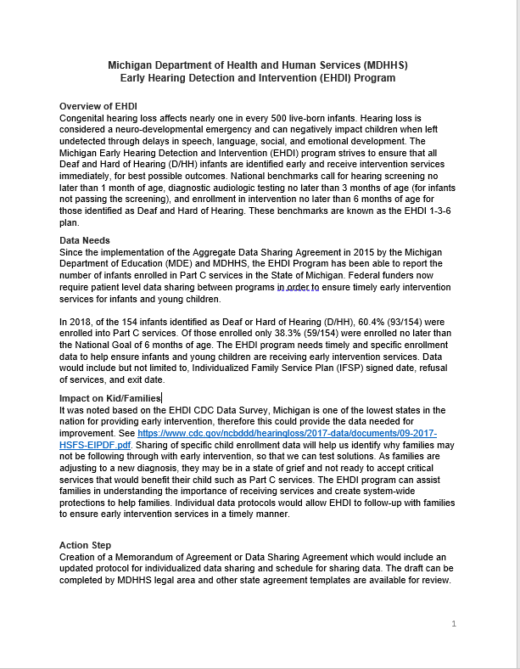
EHDI Formal Request to Early On (IDEA Part C)
Early On recommended formal request be written
Submitted March 2020
One page and included:
  Overview of EHDI
  Data needs
  Impact on families/infants
  Action steps

Slide 40
EHDI and Early On (IDEA Part C) Meeting Including MDE Data Governance
May 2020
Initial discussion:
  Overview of EHDI request
  Aggregate data protocol discussion
  Explanation of IDEA Part C and Center for Educational Performance and Information (CEPI) and Data Sharing Agreement background
Notes:
And then COVID…..

Slide 41
EHDI/Early On Update
August 2020
Quarterly meetings
Covid-19 pandemic
Attendees: Early On, MDE Data Governance DSA Coordinator, EHDI staff
Discussion:
    Possible DaSy assistance
    Other stakeholders needed at table?
    Potential data fields requested

Slide 42
EHDI and Early On (IDEA Part C) Meeting
November 2020
Attendees:
  EHDI
  Early On
  Michigan Department of Education (MDE) Data Governance
  Center for Educational Performance and Information (CEPI)
  MDE Low Incidence Outreach
  DaSy Consultants
Discussion:
  Data elements
  Legislation
  DaSy technical assistance
  Data Sharing Agreement examples
  Next steps

Slide 43
Pros/Cons of Data Sharing by Consent
 | Pros/Advantages | Cons/Challenges
Consent | Will be expedited to begin sharing. Population size may be most efficient. Another agency uses electronic signature which helps. Build stronger relationships with parents and local districts. | Cost of adding a data element. Capture parent consent forms. First year or two are challenging. May not get 100%, data may be skewed. Extra requirement for local service providers which ties to capacity. How and who would be responsible for tracking and analyzing. Need to update parent consent forms along with guidance documents need to be updated.

Slide 44
Pros/Cons of Data Sharing by Data Sharing Agreement
 | Pros/Advantages | Cons/Challenges
Data Sharing Agreement | Department templates available. Center for Educational Performance and Information (CEPI) will need to be involved. Expertise within agency for completing templates. Potentially enhance existing agreement between Early On Data Manager and Center for Educational Performance and Information (CEPI). Receive 100% of data. Don’t need to deal with cons of parent consent. | Timeline for completing. Competing priorities.

Slide 45

Data Sharing Agreement
Large Group and Department leadership approved moving forward
January- June 2021
Collaborative working relationship
Monthly meetings and follow-up emails
Draft, review, revise, review ……Approve!

Slide 46
What’s In Our Data Sharing Agreement
28 sections: Boilerplate language provided that needed specifics added
Introduction
Purpose
Data to be Shared
Method of Transfer
Frequency of Transfer
Availability of Data
Legal Authority
Notices and Consents
Classification
Disclosing Agency’s Responsibilities
Receiving Agency’s Responsibilities
Training
Cost and Damages
Security Breach Notification
Accuracy
Cooperation; Execution of Additional Agreements
Issue Resolution
Notices
Compliance Monitoring
Amendments
Effective Date and Term
Termination
Survival
Entire Agreement
Execution
Successors; Assignment
No Third-Party Beneficiaries
Authority to Bind
Notes:
State of Michigan template Developed by attorney
Template was written for one-way sharing
We adapted it to two-way sharing (vs having two DSAs – one each way)

Slide 47
Larger Group versus Smaller Groups
Larger Group
Data Sharing Agreement versus Consent
Data Sharing Agreement modifications
Smaller Groups
Data elements
EHDI and Early On
  Timelines

Slide 48
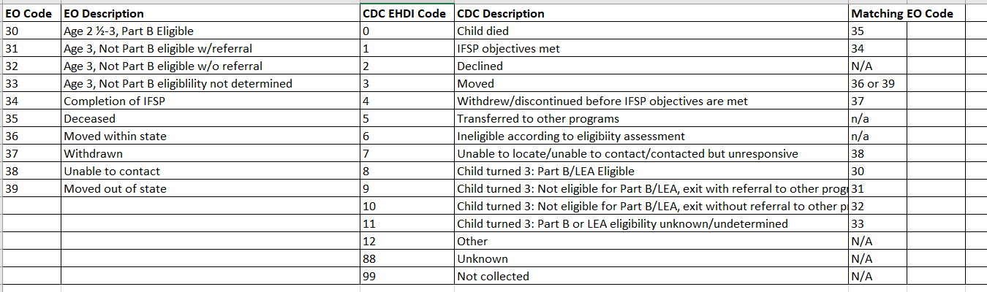
Data Committee: Crosswalk of Data Elements
Early On (IDEA Part C) data elements
Michigan EHDI data elements
CDC data elements
Workflow of how and when: transmission of files
Lessons Learned:
  Example: Early On has three data submissions throughout year from local service areas
  Created crosswalk of exit reasons
Notes:
Matching terminology

Slide 49
Process for Data Sharing
EHDI created data sharing template
1
EHDI creates file with updated demographic information
2
EHDI sends encrypted email to Early On (IDEA Part C) Data Manager
3
Linkage completed with Early On data and file sent back to EHDI
4
Fulfil Data Sharing Agreement Requirements:
5
Tracking log of who and when files are received
Annual check-in to review two parts of agreements:
Compliance monitoring section
Responsibilities of disclosing agencies

Slide 50
Successes
State of Michigan (SOM) Data Sharing Agreement (DSA) template was the same across departments.
SOM DSA template was designed for one-way sharing, needed to adapt to two-way sharing
DaSy assistance was critical to provide technical assistance and lead conversations
Logistics:
  Creating timelines with Task, Steps, Who will complete what and by when helped with keeping everyone on track
  Setting up next meeting right away was beneficial
  Meeting agendas & shared notes with action steps and who was responsible

Slide 51
Opportunities
  Data Sharing Agreement (DSA) requires an evaluation - allows both programs to create and implement action steps based on what we learn
  What happens after 2026 data??
  Established collaborative relationships
  DSA creates a documented process and practice which is critical to continuation of work regardless of staff changes
  Possibilities for enhanced future data analysis

Slide 52
Break

Slide 53

State Data Sharing Examples
Elizabeth Seeliger, Wisconsin Sound Beginnings Program Coordinator
Lori Wittemann, Wisconsin Birth to 3 Program
Christine Kometer, Early Intervention Coordinator CESA #1 Wisconsin Sound Beginnings

Slide 54

Wisconsin State Structure
Early Hearing Detection and Intervention (EHDI) and Part C - under WI Department of Health Services:
Part C - under Division of Medicaid Services
Part C Program, county-based, with 72 individual programs
Part C uses a primary coach approach to teaming in natural environment to deliver early intervention services
No “deafness specific” state-wide intervention program
School for the Deaf outreach program provides training, technical support and materials but no direct Birth to 3 Program services.
EHDI - under Division of Public Health

Slide 55
History of Wisconsin Data Sharing Activities
Intra-agency Memorandum of Understanding (MOU) in place since 2013
  Developed in response to refocus on serving children deaf/hard of hearing (DHH)
  Department determined Wisconsin Sound Beginnings (WSB) is a “participating provider” for the Birth to 3 Program
  Updated every 4 years; last signed in 2021 and effective until terminated;
  reviewed biannually
  MOU addresses protection of personally identifiable data with an annual
  Notification of Parental Rights Regarding Records
Separate data use agreement updated every 4 years
  Recent revision
    Allows for providing data on children not referred via WE-TRAC who are DHH and could be supported by WSB team
    Provides for sharing of child outcomes measurement rating

Slide 56
Wisconsin Data
Wisconsin has approximately 65,000 births per year
120 infants are identified with congenital hearing loss yearly
  All are referred via WE-TRAC to the Birth to 3 Program
  50% receive Individualized Family Service Plans (IFSP) through the Birth to 3 Program
Additional infants are identified with progressive or late onset hearing loss (approximately 5-15 per year)

Slide 57
Wisconsin Data Sharing Process
Home grown data system for EHDI called WE-TRAC
Program Participation System (PPS) is for all Medicaid programs; has a specific Part C module
Audiologist make on-line, web-based referrals directly to Part C data system
100% referral rate since on-line system developed in 2010
Two-way, real-time data exchange – updated nightly (e.g. IFSP date is inputted by county program, it automatically messages data to WE-TRAC system)
Access to WE-TRAC – WI Sound Beginnings Early Intervention and Parent Support team has access to this information for the purposes of outreach and case management
If families move after WE-TRAC referral is made, data from new county program in PPS is updated in WE-TRAC
Birth to 3 Program now receive automated referrals on all infants and toddlers with substantiated cases of abuse or neglect from Child Protective Services

Slide 58
Wisconsin Data Sharing Agreement
Matching data not necessary since referral generated from WE-TRAC
Data shared from EHDI to Part C
  Within data system, share enough information to create a referral record
  Share full diagnostic report outside of the data system
Data shared from Part C to EHDI
  IFSP (enrollment) date, if they re-enroll, move within the state, move out of state, & close reason including transitioned to Part B – Part B eligibility status at the time of transition
  If non-WI birth and receiving Part C services for DHH or deaf/blind (DB), the data is shared with WE-TRAC & WE-TRAC matches on any demographic information available or new record is created in WE-TRAC

Slide 59
Wisconsin Successes and Opportunities for Next Steps
Successes - Buy-in, partnership, process for updating and reviewing, MOU as a documented process and practice is critical to continuation of work regardless of staff changes, increased awareness of unique needs of children DHH served by the Birth to 3 Program, support available from WSB to Part C county programs to support these families as IFSP team members in three of five regions of the state
Opportunities – expansion of support from WSB to Part C county programs in two remaining regions of the state

Slide 60
Wisconsin Points of Contact
Elizabeth Seeliger, Program Director, WI Sound Beginnings Elizabeth.Seeliger@dhs.wisconsin.gov
Lori Wittemann, Children and Family Program Specialist, WI Birth to 3 Program lori.wittemann@wisconsin.gov
Christine Kometer, Early Intervention Coordinator CESA #1 Wisconsin Sound Beginnings ckometer@cesa1.k12.wi.us

Slide 61
Ready for Your Third Gift?
https://www.infanthearing.org/privacy/states.html

Slide 62

Websites
Centers:
ECTA: https://ectacenter.org
DaSy: https://dasycenter.org/
NCHAM: https://www.infanthearing.org/index.html
PTAC: https://studentprivacy.ed.gov/about-us

Slide 63
Wrap Up and Next steps
Put in the chat:
What is the first activity you will do related to data sharing after the conference?
Have you used any of the resources discussed today? Reactions?
What resources or supports would be helpful to you going forward?

Slide 64
Contact Us
Haidee Bernstein, DaSy
haidee.bernstein@sri.com
Evelyn Shaw, ECTA
evelyn.shaw@unc.edu
Sharon Walsh, DaSy
walshtaylo@aol.com
Karl White, Director, NCHAM
Karl.White@usu.edu
Wisconsin​
  Elizabeth Seeliger ​
  elizabeth.seeliger@dhs.wisconsin.gov
  Lori Wittemann
  lori.wittemann@dhs.wisconsin.gov
  Christine Kometer
  ckometer@cesa1.k12.wi.us
Michigan
  Colleen O’Connor
  oconnorc1@michigan.gov
  Michelle Garcia
  garciam@michigan.gov

Slide 65




Thank you
https://dasycenter.org/ Follow DaSy on Twitter: @DaSyCenter | https://ectacenter.org Follow ECTA on Twitter: @ECTACenter | https://www.infanthearing.org/index.html
The contents of this presentation were developed under grants from the U.S. Department of Education, #H373Z190002 and #H326P170001. However, those contents do not necessarily represent the policy of the U.S. Department of Education, and you should not assume endorsement by the Federal Government. Project Officers: Meredith Miceli, Amy Bae, and Julia Martin Eile.

