Slide 1

Parent + Professional
on cCMV
Holly Frigerio, MA
Teacher of the Deaf
Wife
Adoptive Mom to Owen

Slide 2
Holly Frigerio
St. Joseph Institute for the Deaf
B.S., Southeast Missouri State University, 2014
M.A., Fontbonne University, 2017

Slide 3
The Professional
Teacher of the Deaf

Slide 4
What is CMV?
Cytomegalovirus is a common virus that that infects people of all ages. A CMV infection causes cold-like symptoms, such as sore throat, fever, fatigue and swollen glands. These mild Cytomegalovirus symptoms last for only a few short weeks and is rarely a cause for concern for healthy kids or adults. The symptoms are sometimes so mild, resembling a common cold, that most people do not even know they have it. Once the CMV virus is in the person's body, it stays there for life.

Slide 5
CMV Facts:
CMV is a member of the herpes virus family. By 40 years of age, up to 80% of all adults have been infected with CMV.
There is always a small risk for recurrence or reinfection.
1 per every 200 children is born with congenital CMV in the United States, making it the most common congenital viral infection affecting newborns
CMV is very common among healthy children one to five years of age (one in three five-year-olds are already infected)
CMV can be serious in individuals with a weakened immune system or if they are pregnant
Serious CMV disease can be treated with antiviral medications
No CMV vaccine is available
There is screening and testing available (ask your doctor prior to pregnancy about the antibody blood tests: CMV IgG and CMV IgM)
-National CMV Foundation (2020)

Slide 6
The Impact

Slide 7
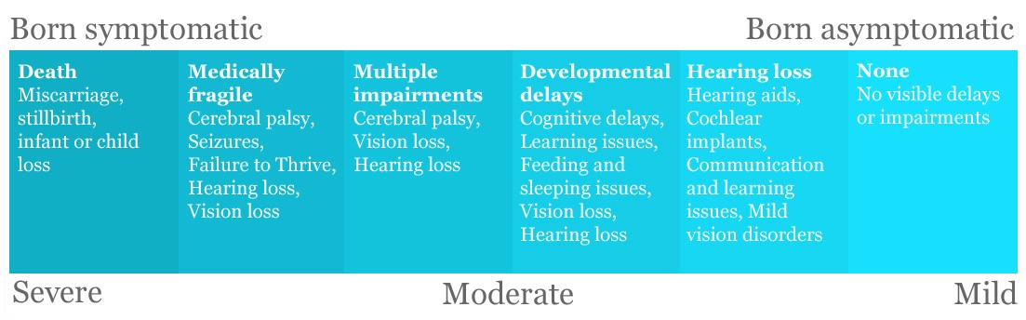
The Spectrum

Slide 8
The Parent
Adoptive Mom to Owen

Slide 9
The Diagnosis

Slide 10
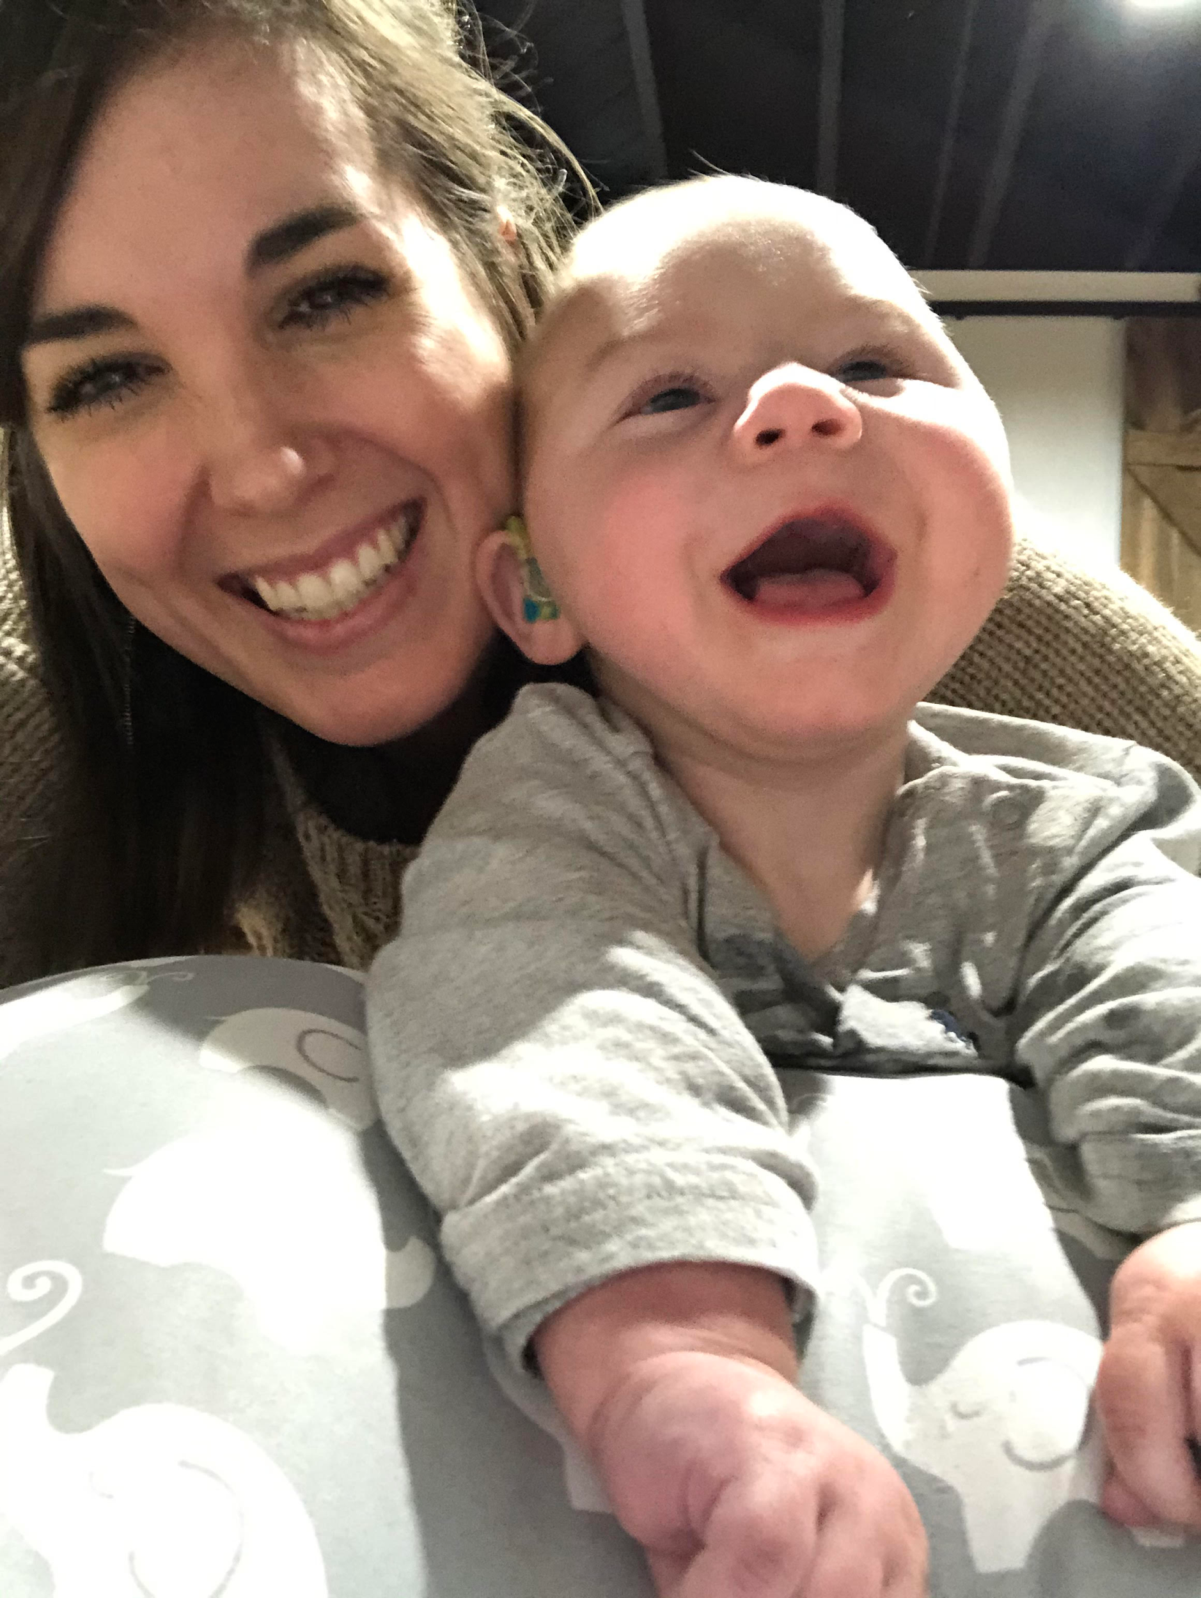
Today
Owen presents with:
Microcephaly
Hearing loss
Suspected Cortical Vision Impairment (CVI)
Epilepsy
Suspected Cerebral Palsy
Pure happiness

Slide 11
Specialists + Therapists Owen frequents:
Neurologist
Pulmonologist
ENT
Audiologist
CP Clinic
Infectious Disease
Pediatrician
Occupational Therapist
Physical Therapist
Nutritionist
Hearing Itinerant

Slide 12
Sources
Dosman, C. F., Andrews, D., & Goulden, K. J. (2012). Evidence-based milestone ages as a framework for developmental surveillance. Paediatrics & child health, 17(10), 561–568. doi:10.1093/pch/17.10.561
National CMV Foundation. (2020). CMV & Pregnancy. Available from https://www.nationalcmv.org/overview/cmv-pregnancy
National CMV Foundation. (2020). CMV Prevention and Healthy Pregnancy Tips [Prevention Tips]. Available from https://www.nationalcmv.org/overview/prevention-tips
National CMV Foundation. (2020). Potential Outcomes for Congenital CMV [Possible Outcomes]. Available from https://www.nationalcmv.org/overview/outcomes
Schleiss M. R. (2018). Congenital cytomegalovirus: Impact on child health. Contemporary pediatrics, 35(7), 16–24.
Notes:
Questions?

