Slide 1

Sound
Support
Ellen Thomas, M.A.
Speech-Language Pathologist, CCC
LSLS Certified Auditory-Verbal Therapist
EHDI Convention
Kansas City - March 2020

Slide 2

What We Know
Services are received from both the medical and educational professionals. Technology changes quickly.
Few families have experience navigating either system and are quickly exposed to an abundance of new information.
Child and family
Physicians
Surgeon
audiologist
Speech-Language
Therapist
Educators
Listening and Spoken Language Specialist
Child Psychologist
The flow of information between medical and educational realms is often limited by regulations (HIPPA/ FERPA), time, ...
Families need emotional support and benefit from sharing experiences with other families.

Slide 3

Bridging a Gap
An outreach program established in 2004 via a Michigan Medicaid matching grant.
50/50 cost-share program between the University of Michigan Department of Otolaryngology and Michigan Medicaid.

Slide 4
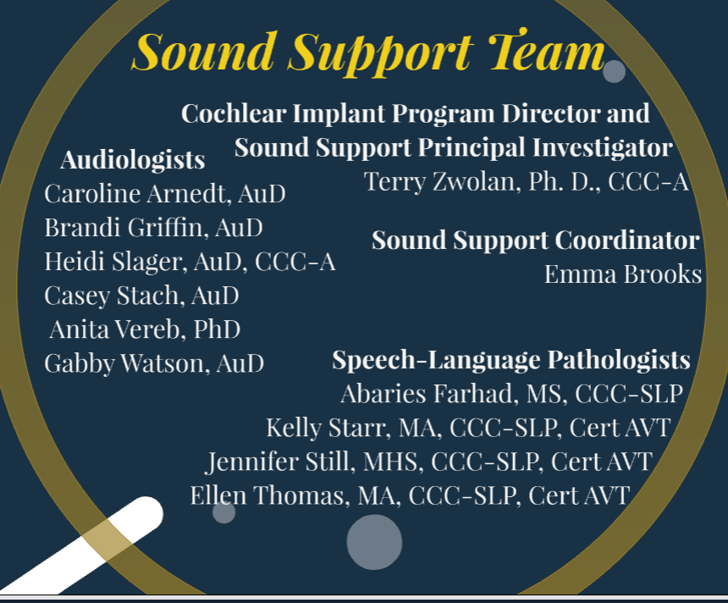
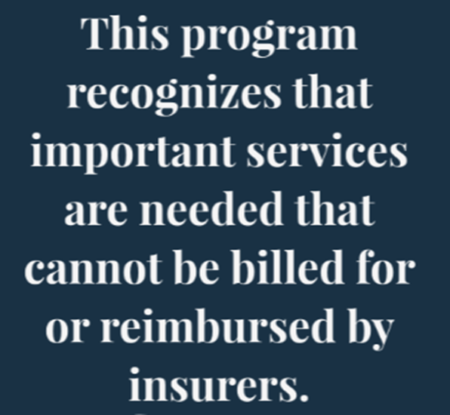
Meeting a Need

Slide 5
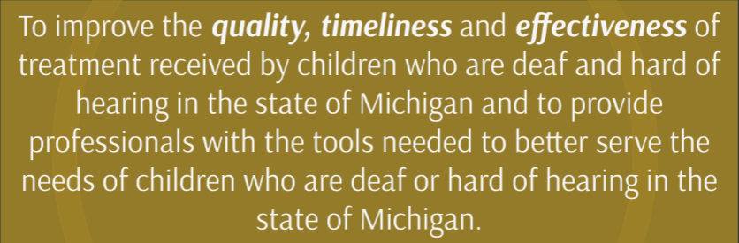
Mission Statement

Slide 6
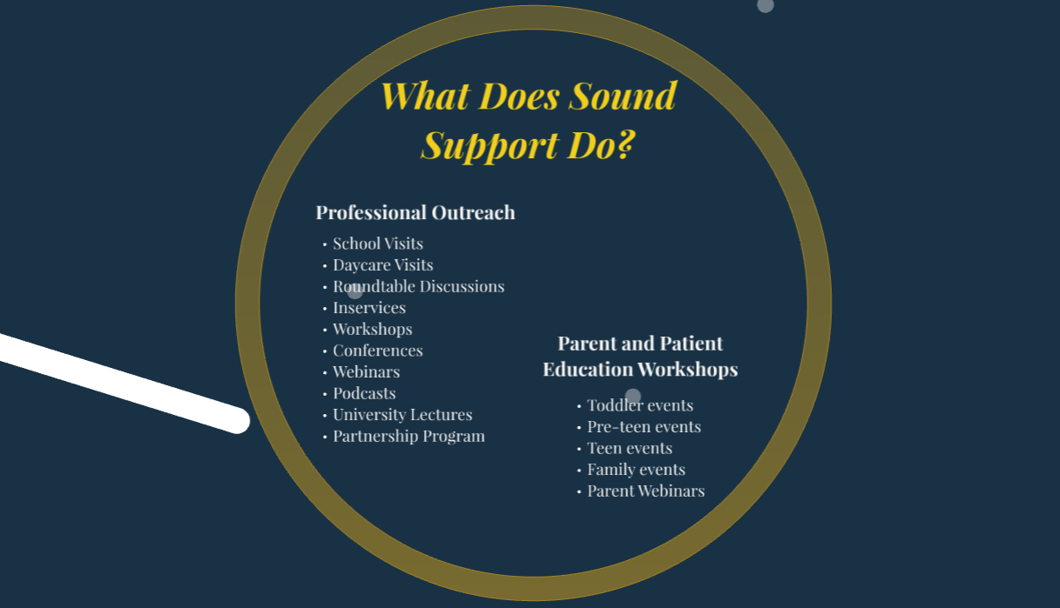

Slide 7
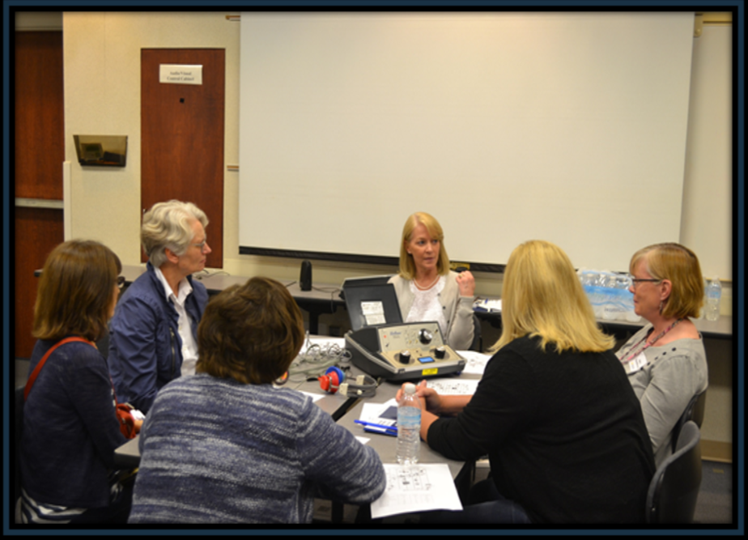
Round-tables

Slide 8
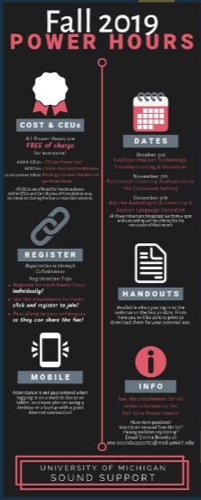
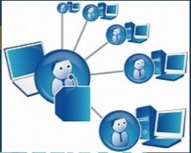
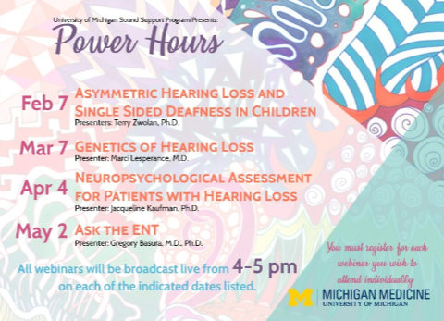
Webinars

Slide 9
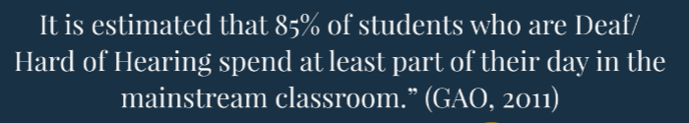

He hears everything.
I talk loudly anyway, so we don’t need a remote mic.
Classroom Collaboration:
Helping teachers understand the hidden
challenges of hearing loss.
Teachers may need recommendations and/or support with remote microphone technology.

Slide 10
Tools for Classroom Assessment
Children’s Auditory Performance Scale (CHAPS)
Functional Listening Evaluation (FLE)
Functional Auditory Performance Indicators (FAPI)
Screening Instrument for Targeting Educational Risk (SIFTER)
https://successforkidswithhearingloss.com/wp-content/uploads/2017/09/SIFTER.pdf
https://www1.phonakpro.com/content/dam/phonakpro/gc_hq/en/resources/counseling_tools/documents/child_hearing_assessment_childrens_auditory_performance_scale_chaps_2017.pdf
https://successforkidswithhearingloss.com/wp-content/uploads/2011/08/FLE-2011_autocalculate_saveable21.pdf
https://www.phonakpro.com/content/dam/phonakpro/gc_hq/en/resources/counseling_tools/documents/child_hearing_assessment_functional_auditory_performance_indicators_fapi_2017.pdf

Slide 11
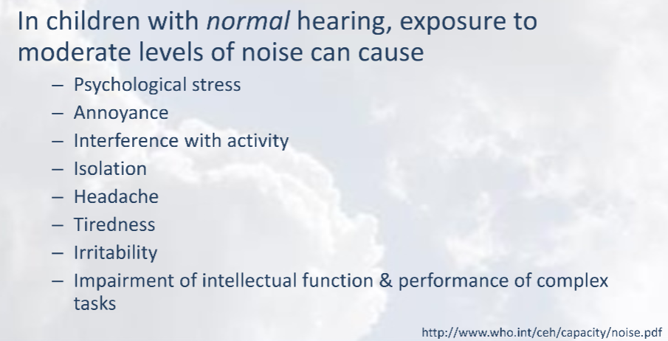
Raise awareness of the problems background noise creates for all students.
Noise effects all students.

Slide 12
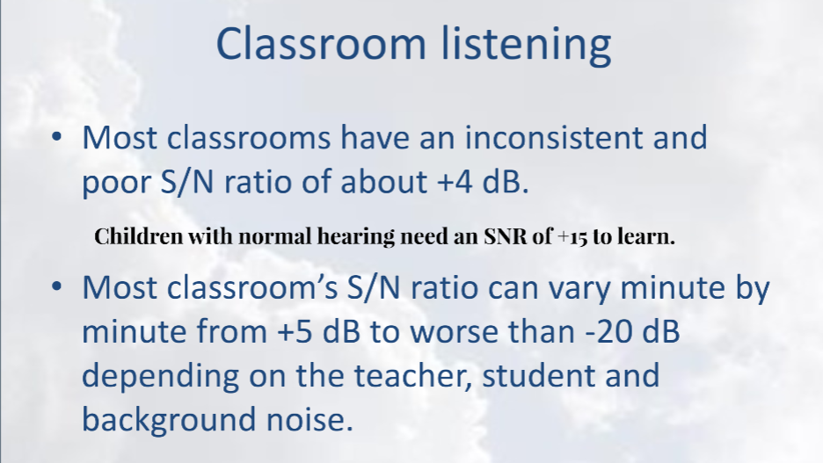
Raise awareness that classrooms are noisy places.

Slide 13
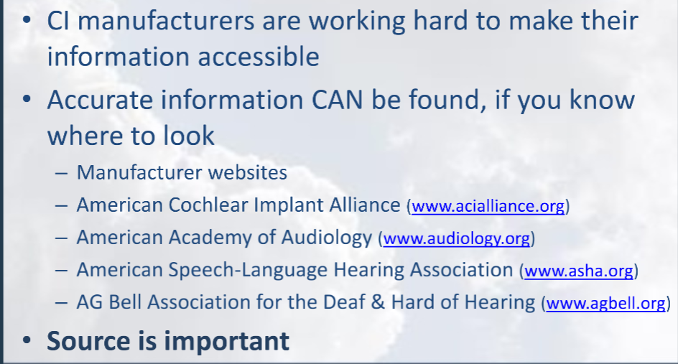
Knowing where to go for reputable online information

Slide 14
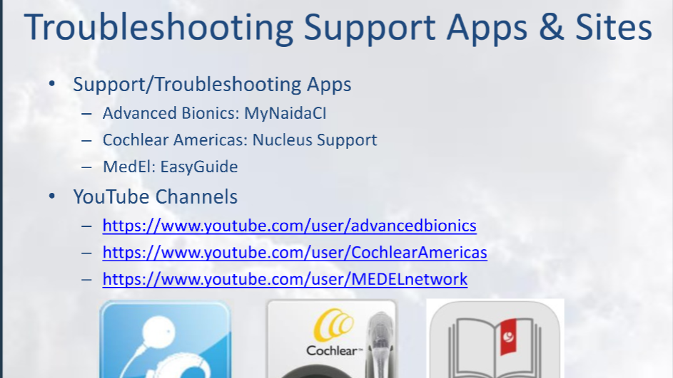
DownloadingApps available to guide adults

Slide 15
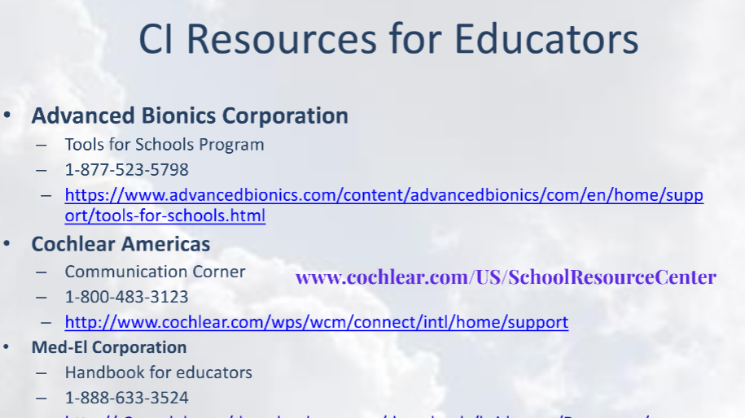
Share Resources especially for educators

Slide 16
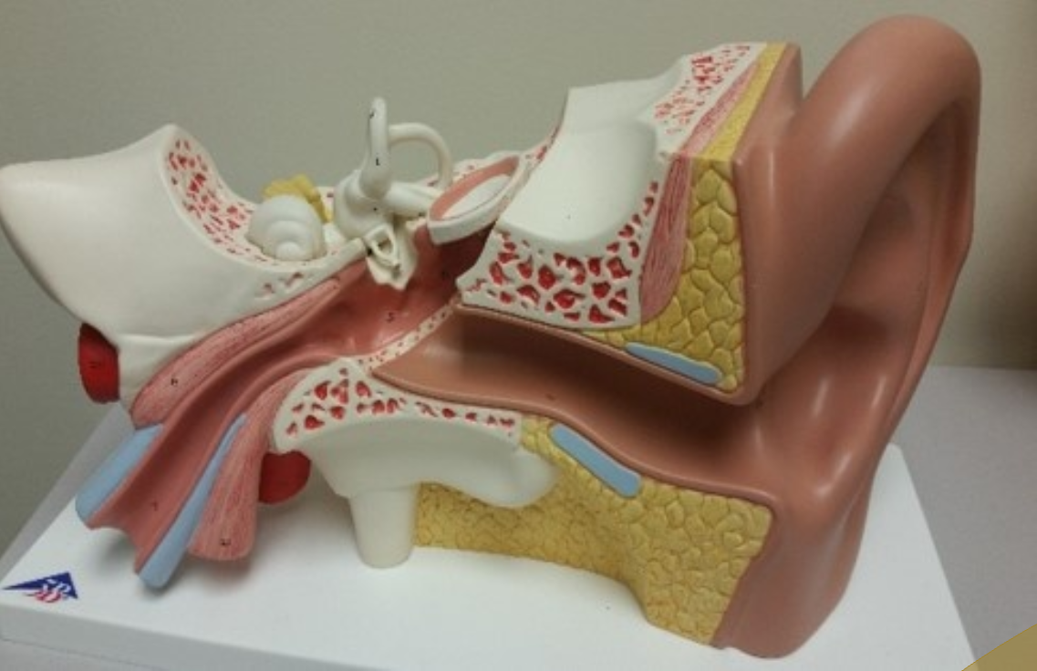
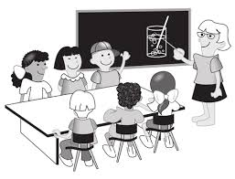


Classroom presenta-tions for students about hearing.

Slide 17
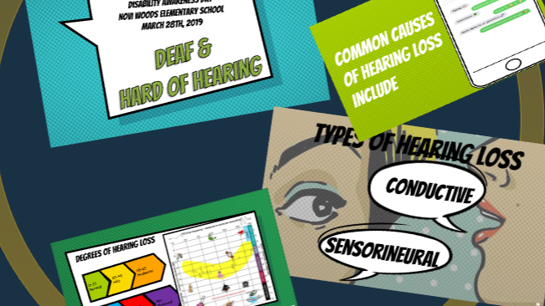
Career Fairs
Notes:
Disability and Career days

Slide 18
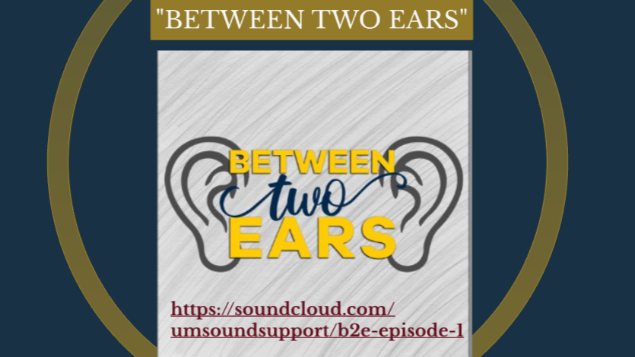
Podcasts

Slide 19
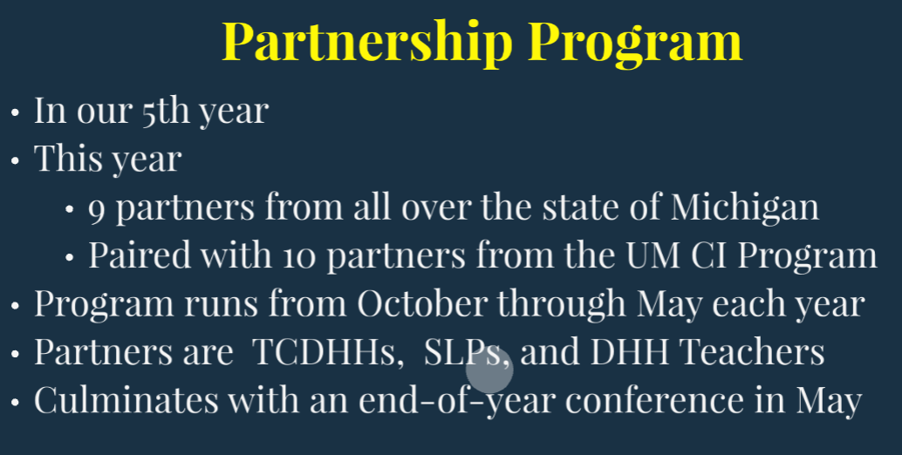

Slide 20
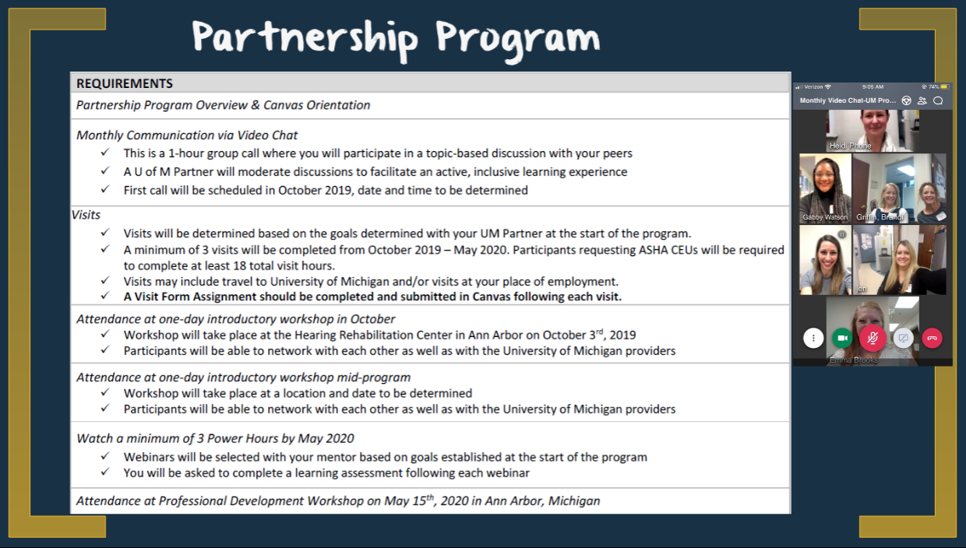

Slide 21
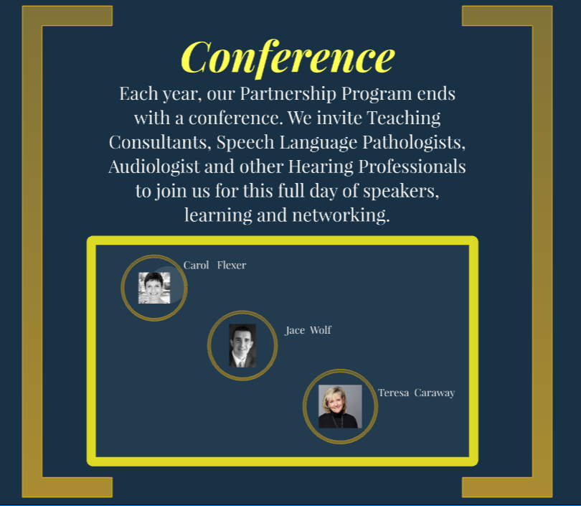

Slide 22
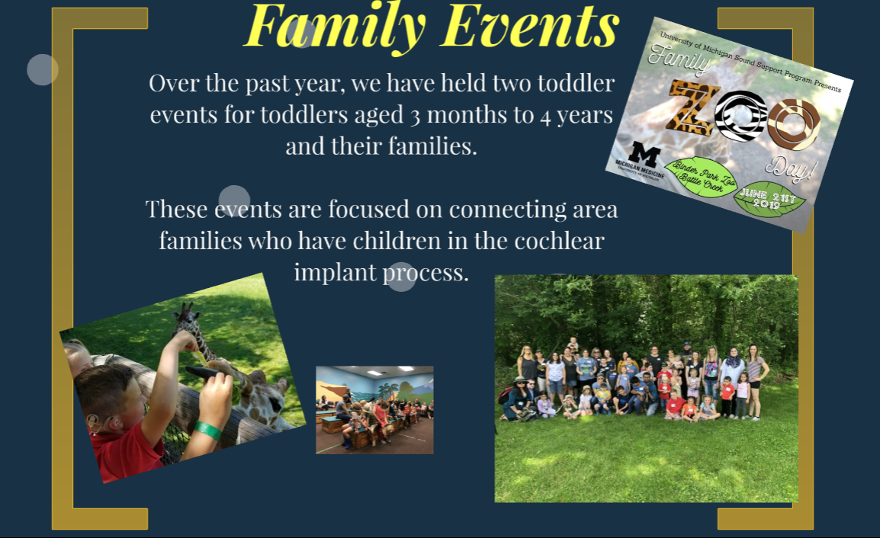

Slide 23
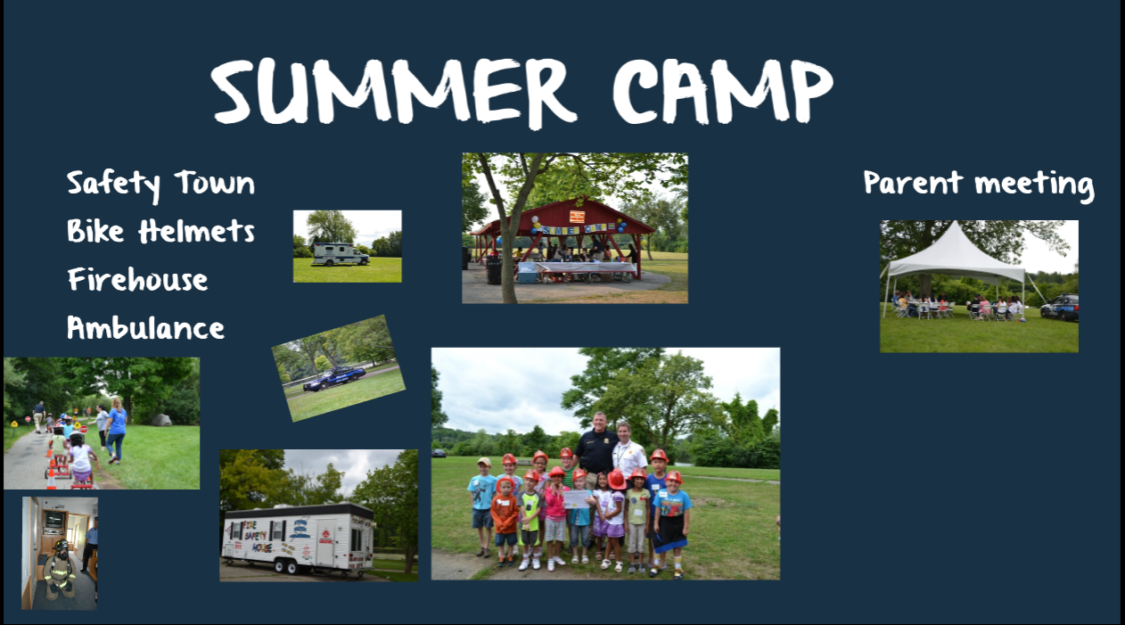

Slide 24


Slide 25
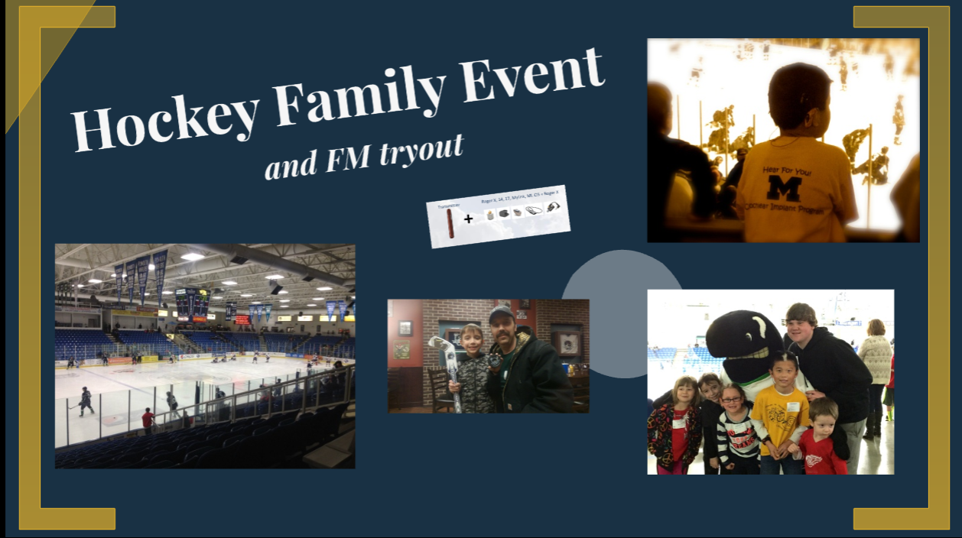

Slide 26
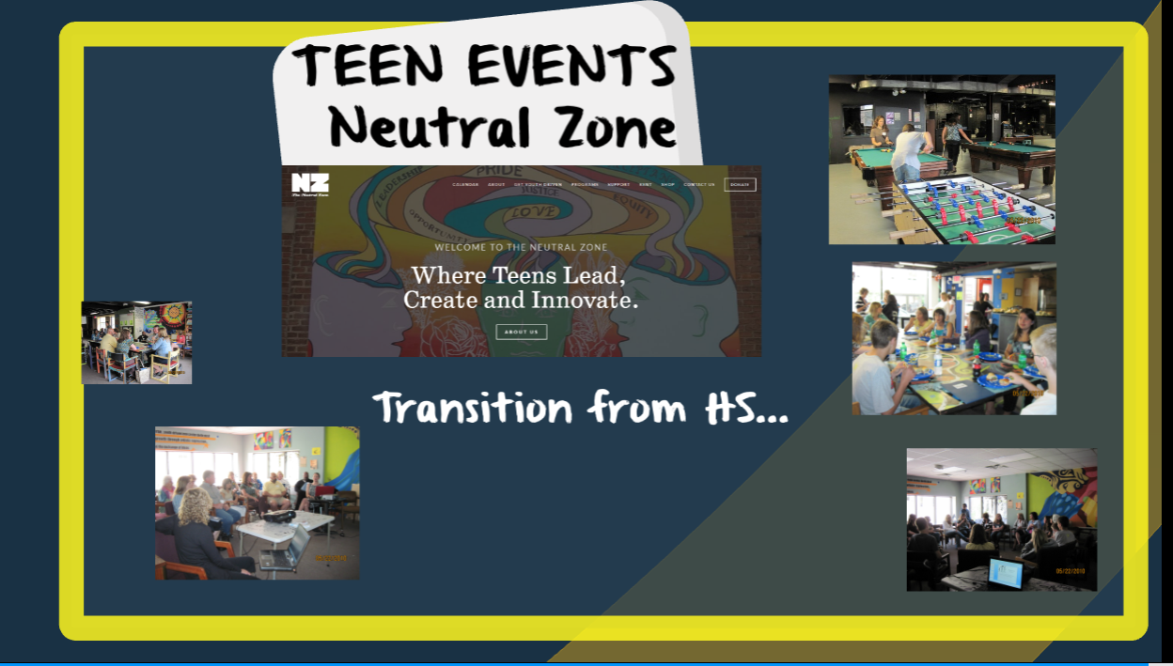

Slide 27

Reaching to Corners of a Large State

Slide 28
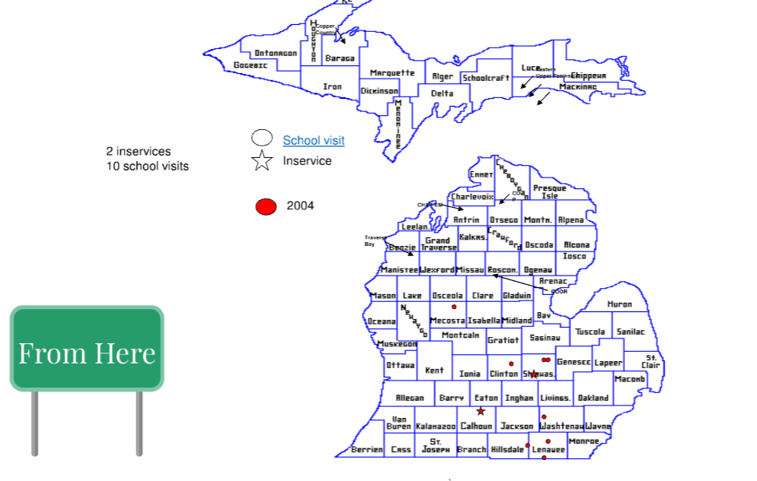

Slide 29
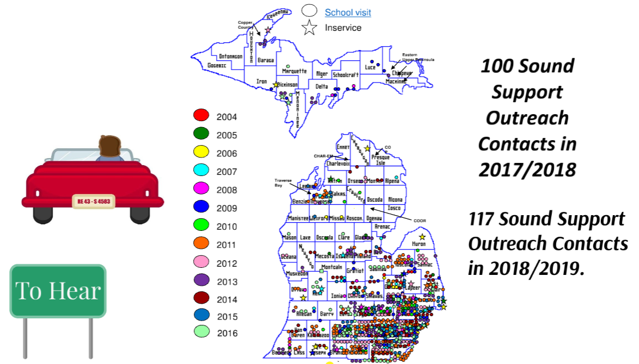

Slide 30
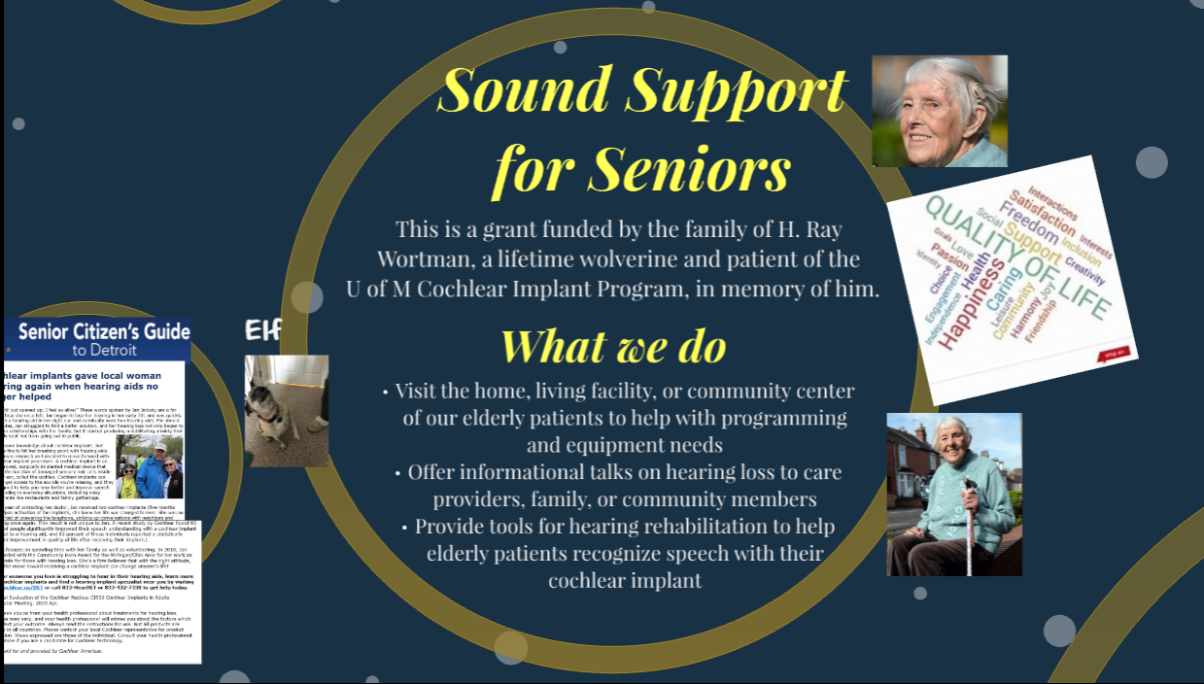

Slide 31


Slide 32

Notes:
Video

