Slide 1

Engaging Families using a Best Practice Resource Tool to Provide Parent to Parent Support
Beth Jones, NV Hands & Voices
Christine Griffin, WA Hands & Voices
EHDI Conference
Tuesday, March 15, 2022
Notes:
Beth & Christine
12:15 -12:16
Hello and Welcome to our presentation: Engaging Families using a Best Practice Resource Tool to Provide Parent to Parent Support
I am Christine Griffin; I am a parent of two adult children who are deaf and hard of hearing. This is what brought me to this arena of parent support within the DHH community. Since stepping up to provide support to families in 2006 for another Family Based Org, Parent to Parent, I began our GBYS program in WA in 2010 and have a M.Ed. is Adult Education focusing on parents as adult learners.
I am joined here today by Beth Jones,
Hi, I’m Beth Jones, Executive Director of NVHV. I have 3 kids, two of who are DHH. I was introduced to H&V soon after my son was identified and have been involved in our chapter ever since. Prior to kids I was a teacher and have a M.ED in Special Education

Slide 2

OUTCOMES:
List three constructs meaningful to provide Parent Support
Learn from examples how to use key elements to support families.
Underline the purpose and benefits for creating a parent support guide/tool
Notes:
Beth
12:16-12:17
.5
In this session our aim for you today is that you will:
List three constructs meaningful to provide Parent Support
Learn from examples how to use key elements to support families.
Underline the purpose and benefits for creating a parent support guide/tool

Slide 3
BEST PRACTICE TRAINING MATERIALS
Notes:
Beth
12:17-12:18
Poll question: Are you familiar with a Best Practice Resource Tool to provide parent to parent support? Yes, No, Not Sure

Slide 4
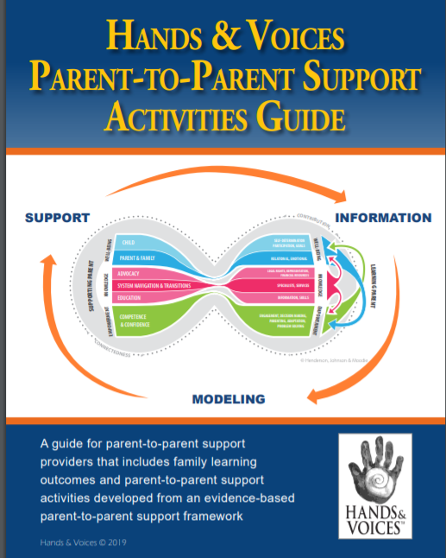
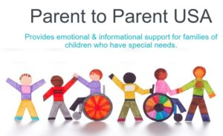


Examples of Family Support Materials
Notes:
Christine
12:18-12:20
2 min
While Beth and I have experience working within the Hands & Voices organization to provide P2P peer support to families of children that are DHH, we want to acknowledge other organizations that may also be offering similar supports. Some examples of on the left of the screen.
For instance, when I began providing parent to parent peer support in 2006, I began working for our county’s Parent to Parent Program.
At that time, we used a notebook to train our “Helping Parents” it had information on the Grief cycle, Communication, the referral process, Helping Parents role, and Resources. After recently reaching out to my colleagues in that program, our state had not yet adopted anything more.
On the right of the screen is an activity guide that trained Parent Guides with Guide By Your Side programs use. In the coming slides we will discuss the research by Dr. Sheila Moodie and offer real life examples of this work.
Right now, We’re curious and want to also shed light on other best practice training resources may be out there.
-If you’re familiar with additional materials from other FBOs to help trained parents offer support activities based on research?

Slide 5
Now that you are a fully trained Parent Leader, how do you really engage families through parent-to-parent support?
Notes:
Beth
12:20-12:21
Many of us Parent Leaders get trained when we first begin to provide services, including how to be un-biased, the roles of our particular jobs, and trainings on local level systems. When I first started out, I thought I was prepared when I made my first call to a parent of a newly identified child who was DHH, but I quickly realized I didn’t know HOW to engage them in the support. As now I supervise a team of 10 others, I realized the HOW was a common question amongst new Parent Support Leaders.

Slide 6
BACKGROUND
Notes:
Christine
12:21
Now we will discuss the background of creating a Best Practice activity guide for Parent Guides.

Slide 7
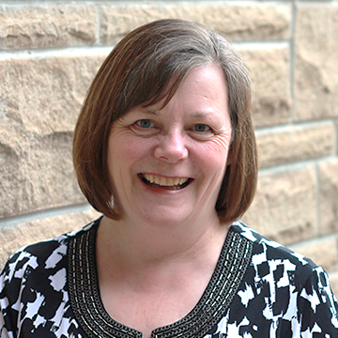
Best Practices in Family-Centered Early Intervention for Children Who Are Deaf or Hard of Hearing
Ensure that all families have access to parent-to-parent support from other families of children who are D/HH.
Recognize the key role of parent-to-parent support in promoting social and emotional well-being for families.
Recognize and actively support parent organizations and networks for direct parent–peer support opportunities.
Support connections between families and adult role models who are D/HH.
(Moeller et al., 2013, p. 435)
American Journal of Audiology • 1–17 • Copyright © 2016 American Speech-Language-Hearing Association
Notes:
Christine
12:21– 12:23
2 min
To start, we want to bring your attention to the work of Audiologist Dr. Sheila Moodie from Western Ontario University who is 2014 and later updated in 2016 her study
entitled,
Parent-to-parent support for parents with children who are deaf or hard of hearing: A conceptual framework.
Dr. Moodie began her researched based on the assertions here by Dr. Mary Pat Moeller of Boys Town. stating that:
-All families have access to P2P support
-Recognize and promote social and emotional well-being.
-Recognize and support p2p organization offering direct peer support.
-Support connection between families and adult role models who are dhh.
From her study Dr Moodie identified three constructs of P2P support for families of children who are deaf or hard of hearing.
Also, We’ve uploaded an article describing the elements of this study to this presentation for further viewing.

Slide 8
CONSTRUCTS
Notes:
Christine
12:23-
Here we will describe the constructs from Dr Moodie’s study.

Slide 9
EVIDENCE MODEL OF PARENT-TO-PARENT SUPPORT
Notes:
12:23-12:25
Christine
2 min
- The Conceptual framework consists of what’s called constructs(left) and components (right).
- The constructs and components are presented in the framework through this closed helix design with the supporting parent and the learning parent at opposite curves.
- The “learning parent” is characterized as having a child recently identified Deaf or HH or could also be a parent who is experiencing something new in their journey of raising their child.
The “supporting parent” has lived experience of having a child who is Deaf or Hard of Hearing and has been trained to supporting other parents.
Well-being, Knowledge, and Empowerment (or as I say confidence) are the three possible outcomes for families who received P2P peer support by a trained family.
Lastly, On the far right there are 3 arrows, each intersecting one another. This visual describe how a construct builds and supports the other constructs. Meaning if a parent has knowledge, they are likely to feel more confident and increased well-being for themself and their child increases.
-This demonstrates the power of P2P support.

Slide 10
REAL LIFE EXAMPLES
Notes:
Christine
12:25
Now we’ll discuss the constructs and give some real-life examples.

Slide 11
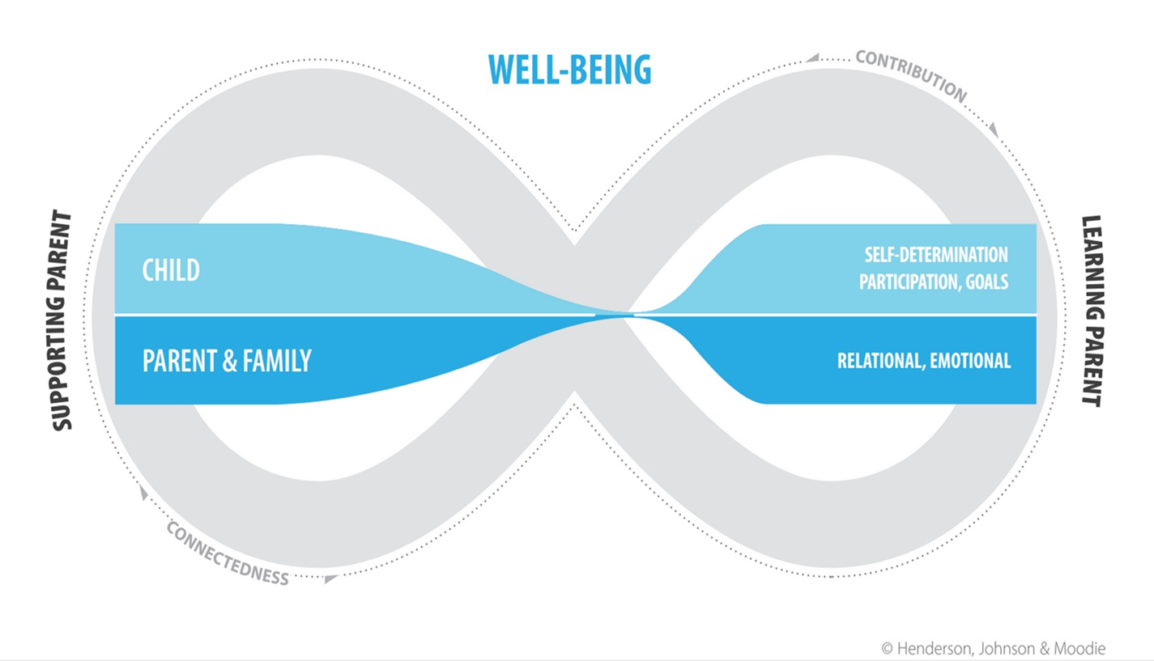
WELL-BEING is generally understood as the dynamic aspects in one’s personal and relational life that affects overall quality.
Notes:
Christine
12:25-12:27
2 min
The first Construct is, Well-Being- for child and family member.
The elements of Well Being are
Self Determination:.
Participation
Goals
Relational
Emotional
A personal example of well-being is when I was called to support a family whose infant had just been identified hard of hearing. The family was a newly blended family with the infant being the connection of the two families. In conversation, the family had shared they had not told their other children, who were picking up on the stress of the parents. They didn’t when or how to share the news with the siblings. They were also fearful of something else happening, waiting for the other shoes to drop. and wondered if they would be ready for it.
One goal many of us work on with new families is the ability to understand their child’s audiogram and then being able to explain it to other family members. Furthermore, we know that family and extended family are an integral part of support to a family.
Therefore, I looked to the construct of well-being to offer my support.
-First, I was able to share my own experience when I first learned my own kids were hard of hearing and what I was able to do.
Next, we were able to discuss ways the parents could inform their other children while giving them helpful tips to ensure connection and communication with their baby sister. I related to this very well because when our kids were both identified, our extended family had no idea how to connect with our children.

Slide 12
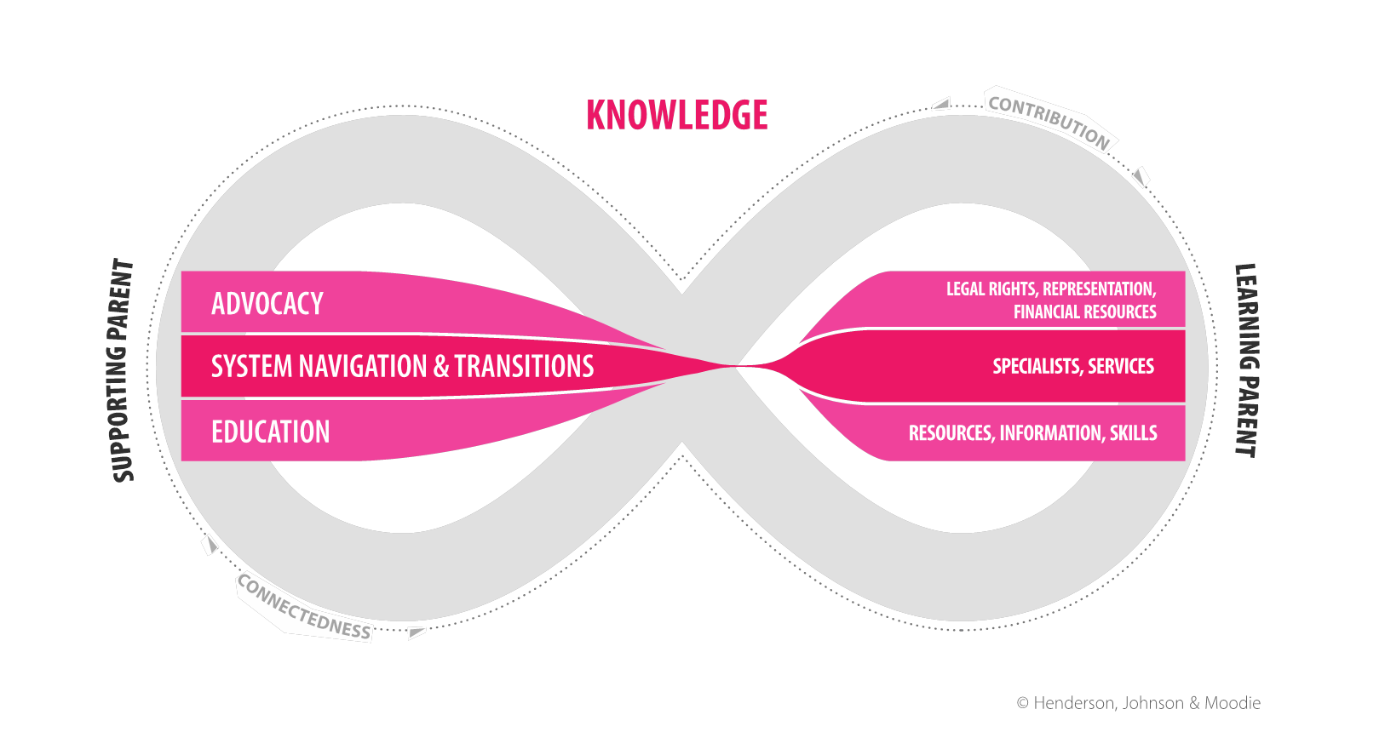
KNOWLEDGE: Parental access to accurate and unbiased knowledge.
Notes:
Beth
12:27-12:29
2 min
The next construct is Knowledge: Parental access to accurate and unbiased knowledge
These include elements such as
Legal Rights:.
Representation:.
Financial Resources Specialists : Services:
Resources and Information
Skills:.
I feel like this is what most people think of when they think about a professional providing support , and while you do not have to be a parent to provide knowledge, the first hand experience can be very beneficial, especially depending on where the parent is on their journey.
One example I came across was working at a joint home visit with another professional. He was going over a HA checklist of if the Dad knew how to tell if battery was dying or dead, how to change the battery using the tools that came with the device, etc. I could tell from the moment I walked in the house the HA was already dead and that the tools were still wrapped in plastic in the hearing aid kit, but the Dad answered yes to all the knowledge questions. As a parent, I changed how I approached the Dad and asked if I could show him how I change my kids’ batteries. Simply by changing the way I assessed his knowledge took the pressure off to saying “yes” or “no” to having knowledge of a specific skill. I demonstrated all the checklist items and gave the dad the knowledge in a different way,.

Slide 13
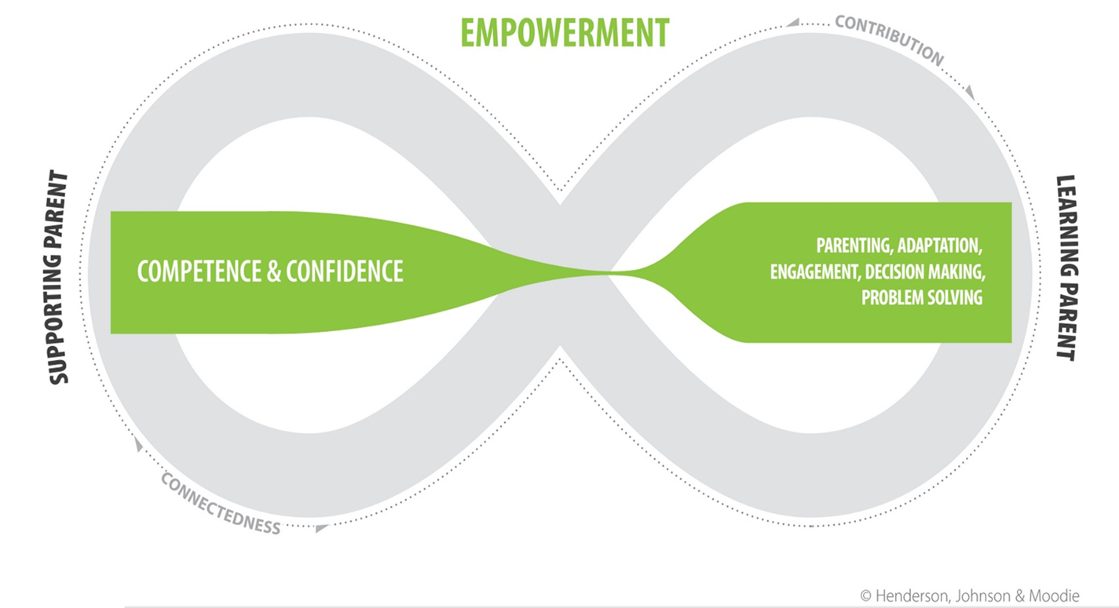
EMPOWERMENT: Utilizing practical day to day skills exchanged by parents with learned experiences
Notes:
Beth
12:29-12:31
2 min
The last construct is my favorite:
Empowerment: Utilizing practical day to day skills exchanged by parents with learned experiences
Engagement: a parent’s ability and readiness to optimize their parental role and engage in their child's habilitation process.
Decision Making : parent-to-parent support that provides access to knowledge and resources, and the opportunity to cultivate ideas for informed choice and decision-making.
Parenting: parenting skills and advice to improve parent-child interactions and encourages responsive parenting to support the child's communication development in daily life.
Adaptation: describes the component of parent-to-parent support that helps with adjustment, acceptance, motivation, hopefulness, resilience, learning and optimism
As Parent leaders, we are not necessarily only supporting the parents to make phone calls to Drs, fill our paper work, or speak for them at meetings. We want to empower them to do this for themselves to make their own decisions. When parents are engaged, they are empowered. When parents feel they have knowledge and skills, they are empowered. empowered.

Slide 14
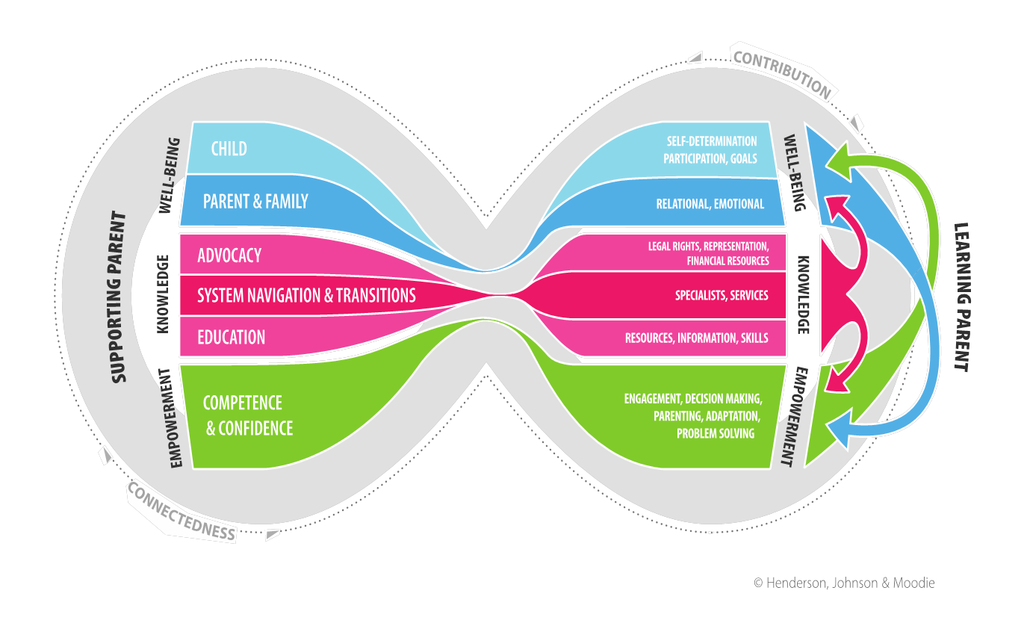
Finally… let’s look at the outer circles
Connectedness
Contribution
Notes:
Christine
12:31-12:32
1 min
The outside arrows of the helix represents the exchange of information.
These are Connectedness and contribution describe the underpinnings of the relationship between the two parents.
There are 3 fluid movements –
Every time I connect with a new family, I learn something new through my own self-reflection and interaction with the family.
This type of connection contributes to the experiential learning for both parents (learning and supportive)
I learn from every family I work with, though for me is working along side families who are culturally diverse is a highlight, and where my learning increases tremendously.

Slide 15
BENEFITS & PURPOSES
Notes:
Beth
12:32
In this next section we will be discussing some benefits of partnering or collaborating with another parent leader/org that could enhance a family’s understanding in specific learning areas.

Slide 16

Parent Perspective
Notes:
Beth
12:32-12:34
2 min
If your organization or State does not have Family Support materials already, some things to keep in mind….
Creating a curriculum can be cumbersome…. Both Chirstine and I were contributors to the H&V Activity Guide and it was not an easy task. Start small or Partner/collaborate with a P2P with an organization which has materials is a great idea
Identifying outcomes that families need to learn. Many jobs or organizations are required to set goals and outcomes for families. If you do, consider identifying what construct may help them at that time (if they are not in a good state of mind or well-being isn’t being taken care of, knowledge won’t come as easily .
Finally, identify goals in each construct if you haven’t already. As Christine mentioned in a previous slide, all the constructs connect with each other. Well being leads to increased empowerment. Empowerment leads to increased well being. And Knowledge leads to both increased well-being and empowerment.
When it comes to training materials for families supporting families, it’s helpful to use materials using researched/best practice resource tool to support families.
As I described earlier about my joint home visit about batteries. The DS was focused on knowledge, but I was able to address his well being. By talking a little, I could see he was overwhelmed by being a single dad and not having these new responsibiilites. By using the P2P activity support guide, I could easily identify an activity to help the parent. By asking, “Let me show you how I change a battery. That knowledge helped lead to empowerment and well being for the Dad. He Felt successful to handle what he felt was an overwhelming task (and speaking as parent of an infant, I’ve had to change batteries in expensive devices with small choking hazards like batteries….it is overwhelming)/

Slide 17

Maintain Fidelity
“What works for your child makes the choice right”
-Hands & Voices motto
Notes:
Beth
12:34-12:36
2 min
From notes: Fidelity-keeping us unbiased we risk talking about our own experiences but not everyone is going to have the same experiences, so this keeps us open.
In all of this support, we want to make sure we maintain fidelity, or staying true to our philosophy of support. There are many ways a family travels to find meaning and support their child, not just one. As we were planning this presentation, we realized that this guide also maintains our devotion for unbiased support of Hands & VOices. The activities and resources are all vetted, meaning embedded into the information is what makes Hands & Voices unique, our ability to adhere to and provide unbiased support.
This way we can support the motto of what works for your child makes the choice right.
There are many ways a family travels to find meaning and support their child.

Slide 18

CONTACTS
Beth Jones
Nevada Hands & Voices bethj@nvhandsandvoices.org
Christine Griffin
Washington Hands & Voices gbys@wahandsandvoices.org
THANK YOU
Notes:
Beth
Thank you
10:36-12:40
Are there any questions.

