Slide 1

The Journey Through Early Hearing Detection and Intervention for Audiologists
Patricia Burk, M.S., CCC-SLP, LSLS Cert. AVT
Debbie Earley, Au.D., CCC-A, F-AAA
Renee Powell, M.P.H
Gina Richardson, M.S., CCPS
Haley Kuck, BS

Slide 2

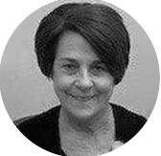
Presenters
Patricia Burk, M.S., CCC-SLP, LSLS Cert. AVT, is the Program Coordinator/EHDI Coordinator for the Newborn Hearing Screening Program at the Oklahoma State Department of Health.
Debbie Earley, AuD, CCC-A, F-AAA, is the Program Manager for the Pediatric Audiology Program for the State of Oklahoma’s Newborn Hearing Screening Program at the Oklahoma State Department of Health in Oklahoma City, OK.

Slide 3

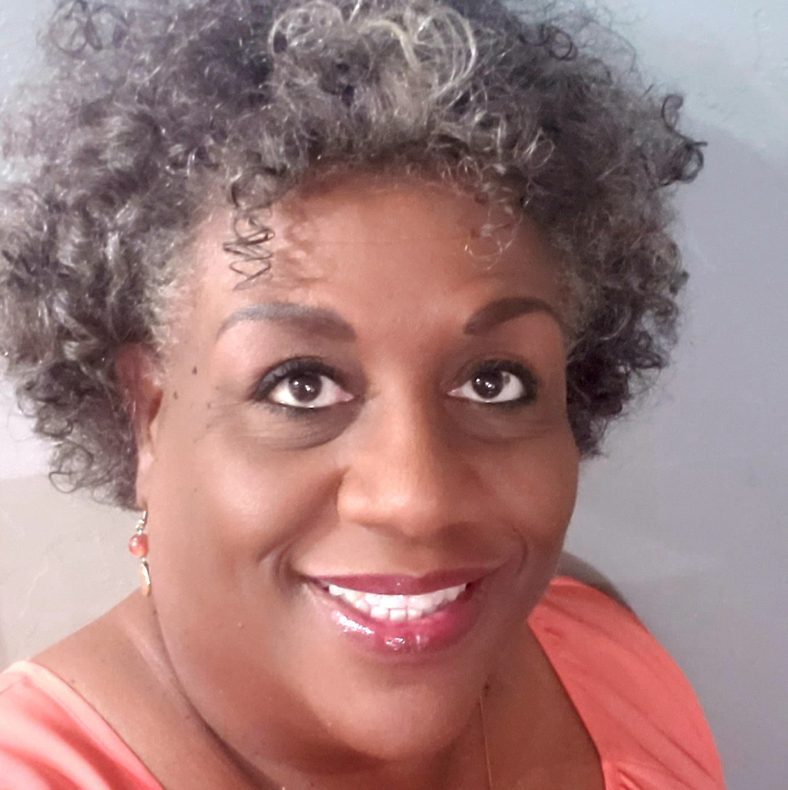
Presenters
Renee Powell, MPH, is a parent of two sons, one of whom has bilateral hearing loss. She works in Bartlesville, OK on the Oklahoma Family Network EHDI Team helping families of children with hearing loss.
Gina Richardson, MS, CCPS, is the Assistant Director for the State of Oklahoma’s Part-C Early Intervention Program, SoonerStart, at the Oklahoma State Department of Health in Oklahoma City, OK.

Slide 4
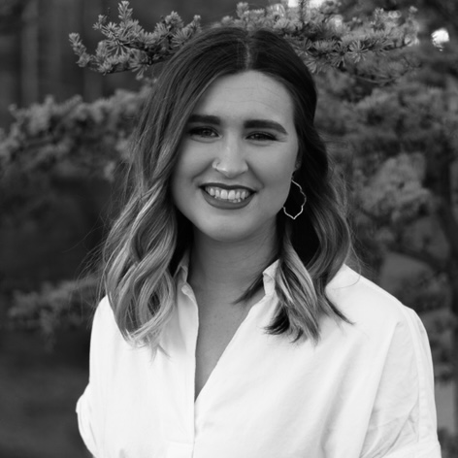
Significant Contributor
Haley Kuck, BS, is an audiology graduate student at the University of Oklahoma Health Sciences Center in Oklahoma City, OK. She developed this presentation as a long-term trainee for the Oklahoma Leadership Education in Neurodevelopmental Disabilities (LEND) program in partnership with the Oklahoma State Department of Health.

Slide 5
Learning Outcomes
After this course, participants will be able to:
Describe the ethical rationale for audiologists functioning as care coordinator in the EHDI process
Describe the ethical rationale for considering whether a specific audiologist is the best resource to serve a family
Summarize the benefits of family partnerships and early intervention

Slide 6
Outline
Background and Rationale (0-5 min)
Newborn Hearing Screening (5-30 min)
Audiologic Diagnosis and Intervention (30-55 min)
The Parent/Family Perspective (55-70 min)
Part C, Early Intervention, and SoonerStart (70-85 min)
Summary and Q&A (85-90 min)

Slide 7
Background and Rationale
Oklahoma Pediatric Audiology Survey – May 4th, 2018
  235 OK Licensed Audiologists
  23% Response Rate
Highlighted results:
  Respondents requested different ways EHDI can support practice, including
    Updates on latest research
    EI referral process
    Help with patient follow through
    Education on ways to report
  52% did not recognize all components of EHDI

Slide 8
What does EHDI Encompass?
Newborn Hearing Screening Program (NHSP)
Partnering with the Medical Home (Primary & Specialty areas)
Partnering with Follow-up Screening Providers & Audiology
Partnering with Early Intervention (EI)
Partnering with Parent-to-Parent Support
Partnering with Deaf/HH Adult Role Models & Mentors and Self Advocates

Slide 9
Newborn Hearing Screening
What do audiologists need to know?

Slide 10
Oklahoma NHSP Team
Patricia Burk, MS, CCC-SLP, LSLS. Cert. AVT
Program Coordinator
Darlene McCann
Administrative Technician III
Vacant
Follow-up/Audiology Coordinator
Ketevan Danelia, PhD
Quality Assurance/Data Coordinator
Desirae White
Administrative Assistant II

Slide 11
History of OK NHSP
1982 | 1983 | 1997 | 2000 |  | 2002 | 2009 | 2010 2013 2018 2021
Law Risk Registry | Implementation of NHSP | Funding Physiologic Screening | Development of Taskforce: Audiology, Early Intervention, and Screening | Law Physiologic + Risk Registry | Hearing Screening ALL hospitals | Revised Oklahoma Audiology Taskforce (OKAT ) | Launched OKAT Subcommittees | Launched Hospital Hearing Reports | Revisions of Subcommittees into Learning Communities & 2-Year Gap Analysis Project | Post-COVID Relaunch
Notes:
Note: timeline to likely be expanded

Slide 12
National EHDI Legislation
Early Hearing Detection and Intervention (EHDI) Act of 2017
  PL 115-71
  Updates to legislation passed in 2010
3 Health and Human Services (HHS) agencies to coordinate nationally
  Health Resources and Services Administration (HRSA)
  Centers for Disease Control and Prevention (CDC)
  National Institutes of Health (NIH)
Reauthorizes funding to improve state EHDI programs from HRSA
Expands program to include young children at risk for late-onset hearing loss
https://www.infanthearing.org/legislation/federal.html

Slide 13
Oklahoma EHDI Legislation
Law Risk Registry: 1982
Updated legislation regarding physiological screening: 2000
Updated legislation in effect as of Sept. 2020
Title 310 – State Department of Health
Chapter 540 – Infant Hearing Screening
310:540-1-3. Guidelines
  Establishes who can screen, how to screen, follow-up and reporting requirements, and timelines

Slide 14
Oklahoma EHDI Legislation
310:540-1-3 Guidelines - Summary
(a) All newborns in Oklahoma shall have a Hearing Screening Procedure completed unless the parent or guardian refuses because of religious or personal objections.
(b) Requirements for the Hearing Screening Procedure
(c) Hospital universal newborn hearing screening administration
(d) Methods for physiologic screening
(e) Personnel and parent notification
(f) Referrals to audiology

Slide 15
Oklahoma EHDI Legislation
310:540-1-3 Guidelines - Summary
(g) Resources for parents
(h) Reporting of Initial Screening
(i) Post-discharge confirmation of results & needed referrals
(j) Reporting of Follow-up screening and diagnostic evaluations
(k) Reporting requirements
(l) Tracking and surveillance
(m) Data reporting

Slide 16
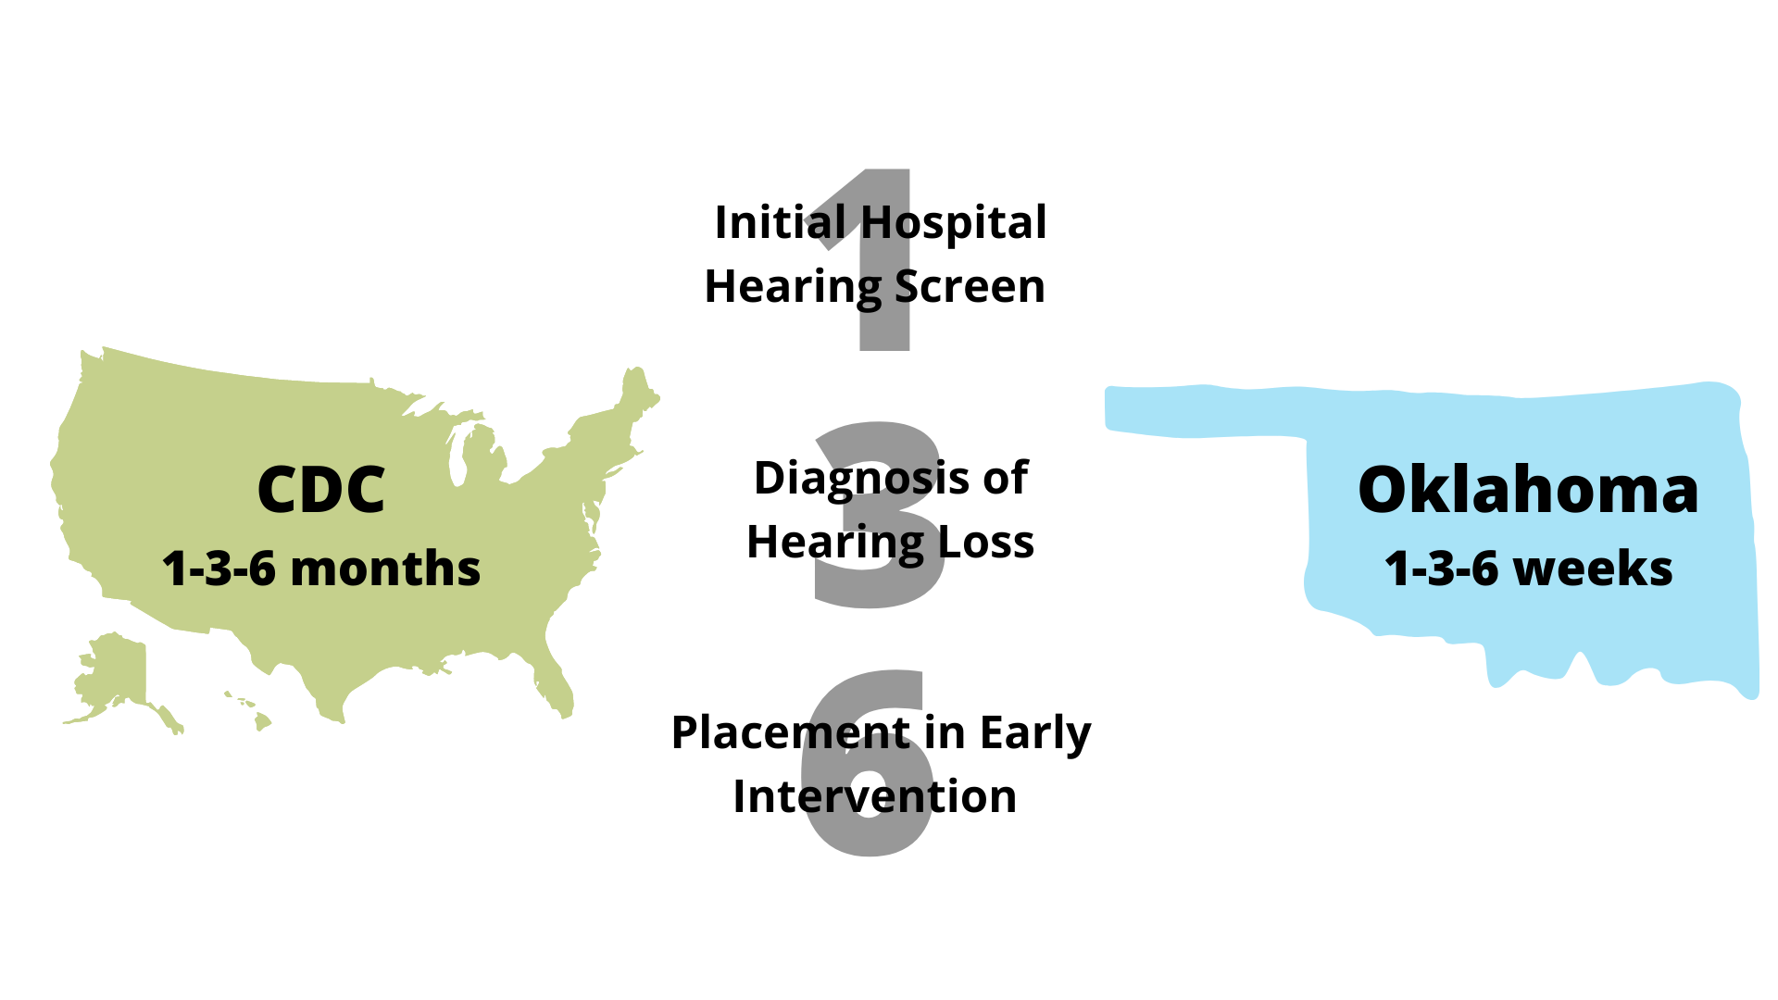

Slide 17
Communicating With Stakeholders
 | Nationally | Oklahoma
Parents | Most important that families understand what is being said and are provided with appropriate resources | Dissemination of brochures with developmental timelines for ongoing hearing monitoring Sends follow-up hearing letters to Parents and Primary Care Providers at 7 days Provides Spanish translation as needed Makes a phone call to parents at 45 days Mails reminder letters at 5 months for babies who passed but are at risk for late-onset hearing loss
Health Care Providers | When a baby fails a NHSP, medical evaluation is essential | Gives providers initial/follow-up results Seeks results for follow-up screenings Assist with continuity of care
State Stakeholders | Effective communication on data management to produce reports on schedule or at request | Quarterly Hospital Hearing Reports to assist with Quality Assurance: Refer, Not Performed, Not Reported Rates Accumulates state statistics for reporting to CDC Creation and distribution of newsletters Oklahoma Audiology Taskforce coordination

Slide 18
The Initial Screening

Slide 19
Statistics Related to Initial Screen
Statistic | Oklahoma 2019 | Nationally 2019
Total Births | 47,413 | 3,604,761
Number Babies Screened | 47,088 | 3,545,388
Percent Screened Total | 99.3% | 98.4%
Percent Screened by 1 Month | 100.0% | 97.7%
Percent Missed | 0.7% | 1.6%
Data Source: 2019 CDC EHDI Hearing Screening & Follow-up Survey (HSFS) (www.cdc.gov/ncbddd/hearingloss/ehdi-data.html)

Slide 20
Who is responsible for screening?
INITIAL: Oklahoma Birthing Hospitals
  Required unless parent/guardian objects
FOLLOW-UP: Providers completing follow-up screens
  Hearing screening completion verified by physician, other healthcare provider, or local county health department staff
  Infants not screened will be referred to trained hearing screener or audiologist
310: 540-1-3
Notes:
INITIAL: Oklahoma Birthing Hospitals
310: 540-1-3 Guidelines (a) All newborns in Oklahoma will have a Hearing Screening Procedure completed unless the parent of guardian refuses because of religious or personal objections.
FOLLOW-UP: Providers completing follow-up screens
310: 540-1-3 Guidelines (i) Physicians, other health care providers, or local county health department staff who examine a child within the first three months of life will verify that the infant's hearing has been screened. Infants not screened will be referred to a health care facility with trained personnel and appropriate equipment for a physiologic screen or an audiologist.

Slide 21
Hospitals’ Responsibilities
Provide a hearing screening (electrophysiologic and identification of risk factors) prior to discharge
Educate parents on importance of early identification
Discuss importance of follow-up
Provide resources for follow-up

Slide 22
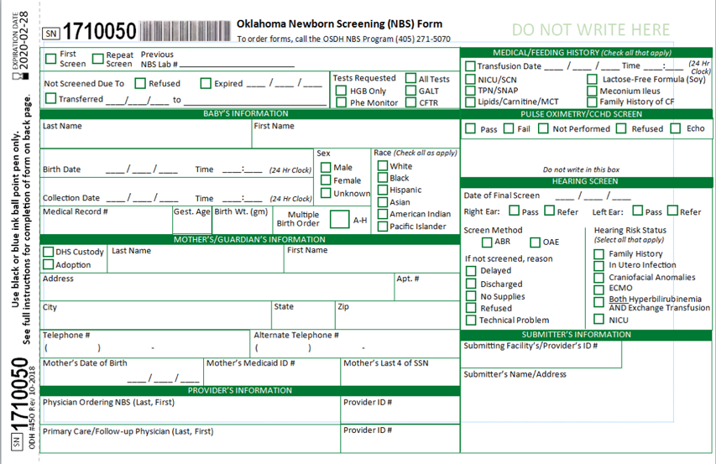
The Filter Form

Slide 23
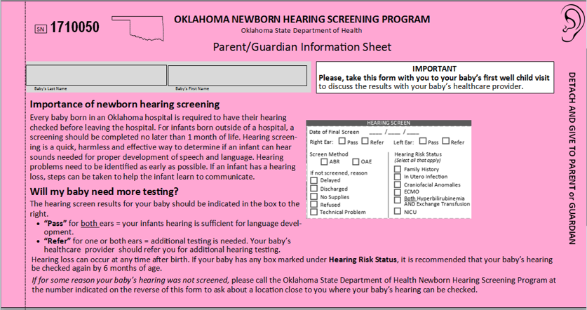
Hearing Results Section

Slide 24
NHSP Collaboration with Birthing Hospitals
Provides hospitals with screening equipment (AABR) at no initial cost; hospital purchase supplies, annual calibration and repairs
Provide training for hospital staff
Provide technical support
Provide brochures in English and Spanish
Ensures hospitals are following state law governing screening and reporting
Notes:
Ensures hospitals are following state law governing screening and reporting e.g. sends lists of babies to hospital to double-check when no results are sent OR are confusing. We are able to do this because, in our state, hearing results are linked to Metabolic Bloodspot testing. Produces quarterly and annual hospital reports.

Slide 25
Hospital Hearing Reports
Quarterly Reports
Annual Reports
Oklahoma Audiology Taskforce | Virtual Meeting | July 30, 2021

Slide 26
Hospital Hearing Reports
Oklahoma Audiology Taskforce | Virtual Meeting | July 30, 2021

Slide 27
Monitor as Various Stages
Weekly
Annually
Quarterly
Oklahoma Audiology Taskforce | Virtual Meeting | July 30, 2021

Slide 28
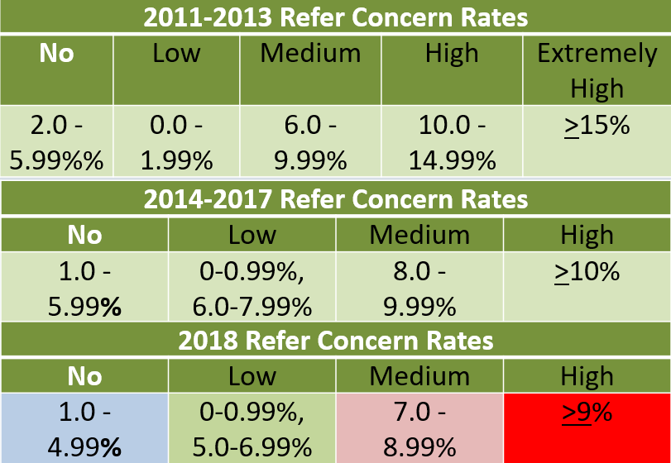
Concern Categories

Slide 29
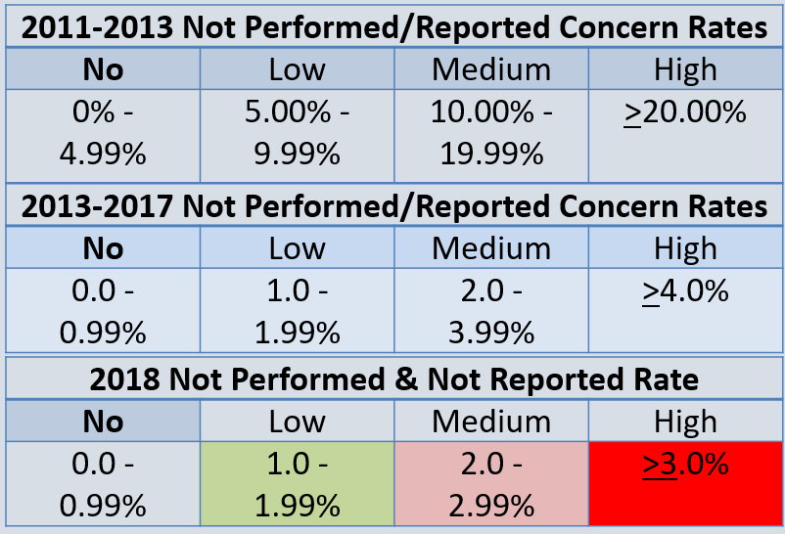
Concern Categories

Slide 30
Hospital Hearing Reports
 | 2013 | 2014 | 2015 | 2016 | 2017 | 2018 | 2019 | 2020
Refer Rate State Average | 5.55% | 5.69% | 5.91% | 4.54% | 4.74% | 4.44% | 4.68% | 5.53%
Total Referred (Not Passed) | 2,840 | 2,913 | 3,020 | 2,273 | 2,285 | 2,101 | 2,194 | 2,487
Not Performed State Average | 0.85% | 0.86% | 0.59% | 0.66% | 0.27% | 0.24% | 0.22% | 0.34%
Sites screening all infants | 12 | 18 | 19 | 24 | 27 | 28 | 28 | 28
Not Reported State Average | 3.12% | 4.28% | 2.72% | 3.02% | 1.75% | 1.27% | 1.31% | 1.64%
Total Not Reported | 1,598 | 2,192 | 1,391 | 1,511 | 842 | 602 | 614 | 739
Total Birth | 51,160 | 51,187 | 51,085 | 50,079 | 48,189 | 47,344 | 46,837 | 44,999
Note: Hospital Reports launched in 2013

Slide 31
NHSP Follow-Up
Babies who Pass Make results available to providers Accumulate State Statistics Provide Spanish translation | Babies who Refer Send follow-up letters to Parents and Primary Care Physicians at 7 days of life Make phone calls to Parents at 45 days if follow-up results have still not been received Help families follow-up with providers
Babies who Pass with Risk Factor(s) Reminder letter at 5 months for babies who passed but are at risk | All Babies Make results available to providers through online portal Accumulate State Statistics for reporting to CDC Provide Spanish translation

Slide 32
Biggest Obstacles to Follow-up
Minimal parental concern/misunderstanding information
Hospital staff may indicate follow-up is not important
Physicians/providers tell parents to wait on follow-up
Few pediatric audiologists
Lack of screening resources in rural areas
Lost to documentation

Slide 33
Partnering with the Medical Home

Slide 34
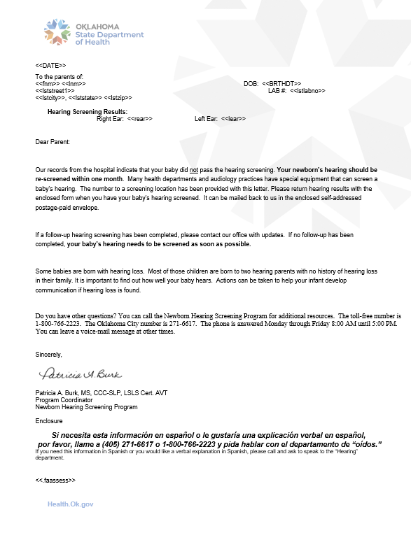
Pediatrician Communication
NHSP sends letters to PCP within 7 days of life for Refers and Not Performed
5 month reminder letters sent to PCP for babies who passed but are at risk for late-onset hearing loss

Slide 35
Medical Evaluation (JCIH 2019)
Medical home to refer child for specialty evaluations
  Otologic
  Genetics
  Ophthalmologic
  Additional medical evaluations as needed
(AAP, 2010; Prosser et al., 2015)

Slide 36
Partnering with AAP
Oklahoma American Academy of Pediatrics (AAP) Chapter Champion:
  Collaborating with Oklahoma Audiology Taskforce
  Outreach to other Medical Home Providers
Oklahoma AAP Outreach
  EHDI E-Mail Express via email
  Articles for OK AAP monthly newsletter

Slide 37
Partnering with Follow-up Screening Providers & Audiology

Slide 38
NHSP Collaboration with Non-Birthing Hospital Providers
All SLP and Audiology university programs in OK
Annual presentation to OU School of Nursing
Oklahoma Midwife Alliance
Hospital Grand Rounds
Women, Infants and Children (WIC)
Children First/Oklahoma Parents as Teachers/Home Visitation Programs
Community Initiatives (ex. Turning Point)
School Nurses Organization
Nurse Practitioners

Slide 39
Audiologists’ EHDI Responsibilities
Obtaining hospital hearing results
Rule out/confirm hearing results using best practice protocols
Report diagnostic results to NHSP in a timely manner
Report hearing aid dates to NHSP
Refer to Early Intervention
Refer to other appropriate services
Notes:
The ones not bolded will be covered later in the presentation

Slide 40
Obtain Hospital Hearing Results
Newborn Screening Results (NBSR) web portal
Protected web-based program allows authorized healthcare providers to obtain newborn screening results (hospital hearing and bloodspot results)
https://nbsresults.health.ok.gov
Requires Facility Site Administrator
Obtaining access to NBSR
        Oklahoma Public Health Laboratory
        405-564-7750
        nbslab@health.ok.gov

Slide 41
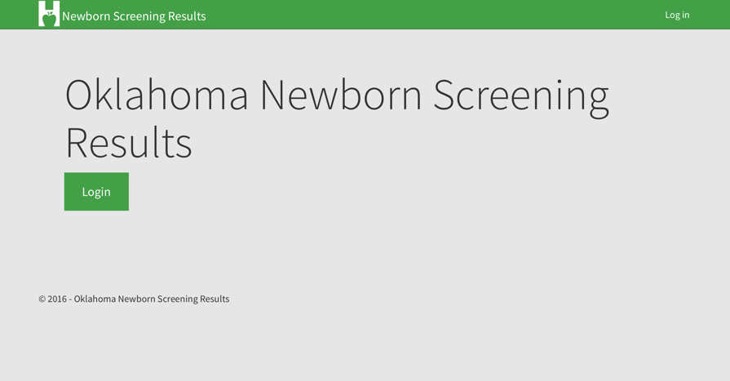

Slide 42
Follow-Up Efforts:
How EHDI Can Help You!
Continuity of care
Contact family
  Assist with no shows
  Send next follow-up letter from state
  Explain importance of testing
  Work with PCP
Resolve results discrepancies between hospital and parent report
Assist with resources in other counties and states
Notes:
Continuity of Care
Assist with No shows
Contact family via phone, send next follow-up letter from state, Explain importance of testing, Work with PCP
If parents say passed at hospital (but state record shows otherwise), EHDI team will request hospital update to confirm
Assist with resources in counties and other states across the nation

Slide 43
Who is responsible for reporting?
INITIAL: Oklahoma Birthing Hospitals
  Providers involved in initial screen
  Sent to OSDH via NHSP filter paper, fax, or secure email
  Sent within one week of performing screen
FOLLOW-UP: Providers completing follow-up screens
  Audiologists or other health care providers involved in completing follow-up hearing screens OR diagnostic evaluations
  Forward results and recommendations to OSDH via fax or secure email
  Sent within one week of performing the hearing screen or diagnostic evaluation.
310: 540-1-3
Notes:
INITIAL: Oklahoma Birthing Hospitals
310: 540-1-3 Guidelines (h) The hospital personnel, audiologist, or other health care provider involved in the initial Hearing Screening Procedure of a newborn will forward results to the Oklahoma State Department of Health via newborn screening filter paper, fax, or secure email within one week of performing the hearing screen.
FOLLOW-UP: Providers completing follow-up screens
310: 540-1-3 Guidelines (j) Health care facilities, physicians, audiologists or other health care providers involved in completing follow-up hearing screens or diagnostic evaluations will forward results and recommendations to the Oklahoma State Department of Health via fax or secure email within one week of performing the hearing screen or diagnostic evaluation.

Slide 44
(1) Reporting
Why to Send?
  Ensure that appropriate follow-up has occurred
  Help reduce confusion and stress for parents by eliminating second letter, calls, etc.
  It's the law!

Slide 45
(2) Reporting
Whose Results to Send?
  Any baby who did not pass the screen at birth.
  Any baby who did not receive a screen at birth.
  Any child with a risk factor for hearing loss.
  Any child diagnosed with hearing loss up to the age of 3 years (unilateral and bilateral).

Slide 46
(3) Reporting
When to Send:
  When screening following hospital discharge.
  When attempted screening or evaluation (continue until hearing status is determined).
  When referring to another audiological site for additional testing.

Slide 47
(4) Reporting
What to Send*:
  Presence or absence of hearing loss.
  Degree and Type of Loss & Date of Diagnosis
  Assistive Device (HA, CI, etc.) & Date
  Enrollment in Early Intervention
  Other referrals, genetics, ophthalmologist, etc.
  Results Inconclusive? Tell us anyway!
* The OK NHSP provides a pre-populated form along with the parent letters. Encourage families to bring this with them to their baby’s screening appointment.

Slide 48
Referrals (JCIH 2019)
Copy of diagnostic report sent to PCP and the state EHDI program with recommendations for medical and otologic evaluations
Referral to Part C early intervention program with a goal of 48 hours (JCIH, 2013) after diagnosis

Slide 49
(5) Reporting
Report even if “inconclusive”
Report “No Shows”
Report any follow up audiology dates
Report hearing technology fitting dates
Report EI referral dates

Slide 50
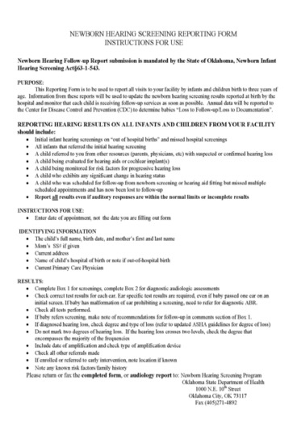
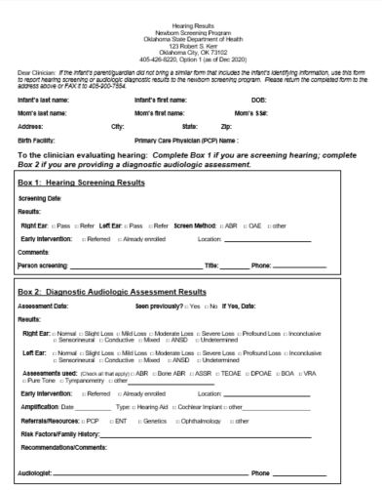
Updated Reporting Form
Available online at http://nhsp.health.ok.gov under Hearing Screening Brochures and Forms

Slide 51
(1) Follow-Up: Tips for Reporting
Baby’s DOB and biological mom’s FIRST name
  Include biological mom’s FIRST name on all results/reports sent to NHSP.
  If in foster care, please ask if the biological mom is known
    A large percentage of foster children in OK are in “kinship placements,” meaning that the name of bio mom is often known to the foster family.

Slide 52
(2) Follow-Up: Tips for Reporting
Send reports after each clinic visit, even if results are inconclusive
Do NOT hold on to reports waiting to rule in/out hearing loss
Remember: While you are waiting, NHSP is contacting families and PCP’s, not knowing that child is already appropriately accessing care (1-3-6).

Slide 53
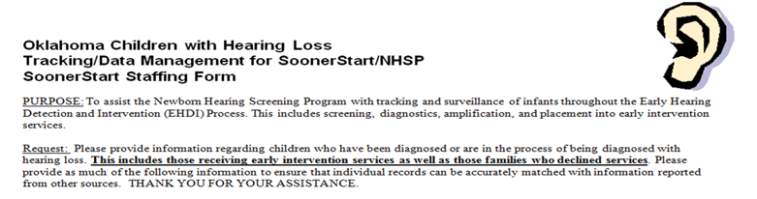
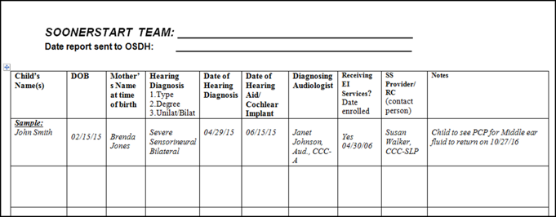
Part C EI Tracking Forms

Slide 54
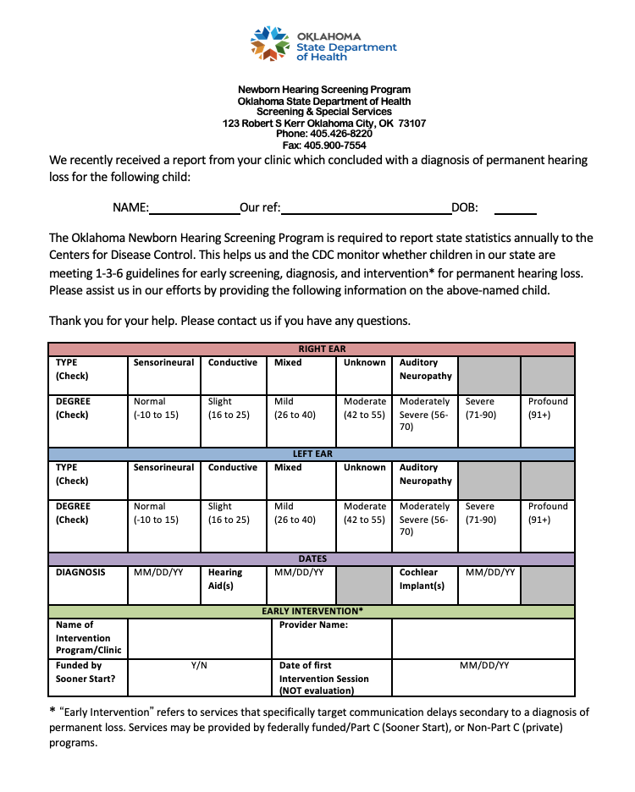
Audiology Reverse Tracking
Request for missing data sent by fax weekly, or as needed
Avoids cases being deemed “Loss to documentation”
Clinics given 1 week to respond

Slide 55
Sensing a Problem with a Hospital?
NHSP can help!
NHSP will request updates from hospitals for missing/ conflicting results; results will go on Quarterly Hospital Hearing Reports for Quality Assurance purposes
Notify NHSP about problems you are seeing from hospitals
  Numerous refers
  Poor parent education
  Telling parents not to worry
Ask parents to contact our team to share their story

Slide 56
Refer to Other Appropriate Services
Work with medical home for these referrals
  Otolaryngologist
  Genetics
  Ophthalmologist
Work with partners for these referrals
  Parent-to-Parent Support
  Deaf/HH Adult Role Models & Mentors

Slide 57
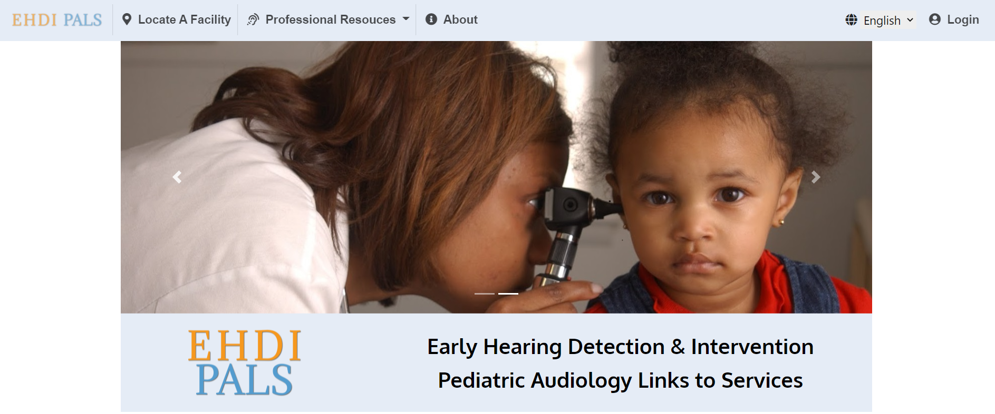
EHDI PALS
https://ehdi-pals.org/
Efforts now being led by NCHAM
Make sure to update your information

Slide 58
Summary
Audiologists can look at initial results through the web-based portal
NHSP contacts audiologists for missing diagnostic results and for EI referral information
NHSP contacts hospitals for conflicting information reported by audiologists/parents
All pediatric audiologists licensed in the State of Oklahoma are invited to submit their information to the EHDI-PALS database

Slide 59
Contact NHSP
Call: 405-426-8220 or
1-800-766-2223, Option 1
Fax: 405-900-7554
OSDH.NewbornHearing@health.ok.gov

Slide 60
Jennie’s Story
*2-3 minute family story video here*

Slide 61
Audiologic Diagnosis and Treatment
What are my ethical responsibilities?

Slide 62
OSDH Pediatric Audiology Program Team
Debbie Earley, Au.D., CCC-A
Program Manager
Jillian Detwiler, Au.D., CCC-A
Clinical Audiologist
Jessica Huddleston, BS
AuD Student Extern

Slide 63
What are my ethical responsibilities related to EHDI?
Performing hearing assessments using best practice protocols
Communicating screening results to families, primary care physicians, state EHDI system, and diagnostic audiology centers, as indicated.
Referring infants for audiologic and medical services, as indicated.

Slide 64
AAA Code of Ethics
PRINCIPLE 2: Members shall maintain the highest standards of professional competence in rendering services.
  Rule 2a: Members shall provide only those professional services for which they are qualified by education and experience.
  Rule 2b: Individuals shall use available resources, including referrals to other specialists, and shall not give or accept benefits or items of value for receiving or making referrals.

Slide 65
(1) ASHA Code of Ethics
Principle I: Individuals shall honor their responsibility to hold paramount the welfare of persons they serve professionally or who are participants in research and scholarly activities, and they shall treat animals involved in research in a humane manner.
  Rule A: Individuals shall provide all clinical services and scientific activities competently.
  Rule B: Individuals shall use every resource, including referral and/or interprofessional collaboration when appropriate, to ensure that quality service is provided.

Slide 66
(2) ASHA Code of Ethics
Principle II: Individuals shall honor their responsibility to achieve and maintain the highest level of professional competence and performance
  Rule A: Individuals who hold the Certificate of Clinical Competence shall engage in only those aspects of the professions that are within the scope of their professional practice and competence, considering their certification status, education, training, and experience.
  Rule G: Individuals shall make use of technology and instrumentation consistent with accepted professional guidelines in their areas of practice. When such technology is not available, an appropriate referral may be made.
  Rule H: Individuals shall ensure that all technology and instrumentation used to provide services or to conduct research and scholarly activities are in proper working order and are properly calibrated.

Slide 67
(3) ASHA Code of Ethics
Principle IV: Individuals shall uphold the dignity and autonomy of the professions, maintain collaborative and harmonious interprofessional and intraprofessional relationships, and accept the professions' self-imposed standards.
  Rule A: Individuals shall work collaboratively, when appropriate, with members of one's own profession and/or members of other professions to deliver the highest quality of care.

Slide 68
Roles of the Audiologist (JCIH 2019)
Diagnostician
Case Manager
Communicating the information to the family in an empathetic, non-biased, open-ended fashion, and in a language that is accessible to the family
Most often responsible for referral to early intervention system
Providing information about amplification options etc.
Providing or referring to appropriate clinic to obtain hearing technology
Connecting parents to other parents

Slide 69
The Diagnostic Assessment
JCIH Position Statement 2019

Slide 70
Minimum Test Battery
Minimum test battery to include:
  Auditory Brainstem Response
  Tympanometry and/or wideband reflectance
  Acoustic Reflexes
  Otoacoustic emissions (OAEs)
  Behavioral Assessment after 6 months
    VRA: 6-24 mo
    CPA: 24 mo +
Source: JCIH Position Statement, 2019

Slide 71
Auditory Brainstem Response Testing
Auditory Brainstem Response:
  Natural sleep usually feasible
  Frequency-specific tone-burst stimuli to determine thresholds and set Has-clicks should not be substituted for tones, used to assess ANSD
  Both air and bone conduction to determine type
    Need minimum of 2 frequencies per ear to appropriately fit with amplification
  If no response:
    High intensity click stimuli with positive and negative polarity to assess for auditory neuropathy.
  ABR is not a test of hearing; thus, behavioral evaluation is required once the child is developmentally capable
  The presence of ME effusion is not a contraindication to testing.
    Do not delay testing until effusion is cleared
Source: JCIH Position Statement, 2019

Slide 72
Middle Ear Measures: Tympanometry and Acoustic Reflexes
  Tympanometry: assists in differentiating conductive vs sensory/neural site of lesion
    High frequency tympanometry (1000 Hz probe tone) is recommended through age 9 months due to better specificity and sensitivity in detecting middle ear effusion
  Wideband reflectance: can detect conductive hearing loss and is sensitive to ME disorders
    Technique may supplement tympanometry and may replace tympanometry in coming years
Source: JCIH Position Statement, 2019

Slide 73
Acoustic Immittance Testing Considerations
Use of both the 1000 Hz and 226 probe tone may be considered for use with infants between 6 and 9 months of age
When testing reflexes using a 1k Hz probe tone, do not test reflexes at 1000 Hz because of potential for interaction.
  remember an upward deflection may be observed as opposed to the typical downward decrease in deflection
  maximum stimulus level should not exceed to 105 dB HL
  broadband noise may be preferable
  acoustic reflex is nearly always absent or elevated in cases of auditory neuropathy
Source: JCIH Position Statement, 2019

Slide 74
Otoacoustic Emissions
Only offer information about cochlear activity and cannot determine normal auditory function when used in isolation
Useful as cross-check measure to confirm results
Present DPOAEs usually indicate thresholds no worse than 30 dB HL
Absent DPOAEs (with normal tympanometry) usually indicate thresholds worse than 30 dB HL
Source: JCIH Position Statement, 2019

Slide 75
(1) Questions to Ask
Do I have an FDA-approved AEP computer with inserts, supra-aural headphones, and bone oscillator?
Do I have equipment capable of performing diagnostic OAEs?
Is my immittance bridge capable of producing both a 226 Hz and 1000 Hz probe tone?
If the answer to any of these is no, Refer!
ASHA Principle II, Rule G: Individuals shall make use of technology and instrumentation consistent with accepted professional guidelines in their areas of practice. When such technology is not available, an appropriate referral may be made.

Slide 76
(2) Questions to Ask
Do I have the necessary training required to perform all the testing in the minimum test battery?
Am I comfortable performing diagnostic testing on infants?
If the answer to any of these is no, Refer!
ASHA Principle II, Rule A: Individuals who hold the Certificate of Clinical Competence shall engage in only those aspects of the professions that are within the scope of their professional practice and competence, considering their certification status, education, training, and experience.

Slide 77
Amplification

Slide 78
Candidates for Amplification
Bilateral SNHL
Aidable unilateral HL
Mild HL
Children with ANSD should have a trial with amplification
  Unless it is established that child responds to conversational speech without them
Permanent CHL
Transient CHL if cannot be resolved by 6 months
Children with profound HL
  Should not be excluded from receiving amplification while awaiting CI evaluation

Slide 79
AAA Principles for Effective Pediatric Fittings
Bilateral amplification is recommended for most
  Monaural for some specific needs.
Air conduction HAs unless not anatomically possible
BTEs are the style of choice
  Good for growing ears
  Necessary pediatric features can be included
For infants, earmold replacement may be as frequent as monthly
All verification should be performed after the activation of any modern feedback suppression algorithm
Full time directional processing is not recommended
Source: AAA Pediatric Amplification Practice Guidelines (June 2013)

Slide 80
Fitting and Verification
Two options for hearing aid verification
  REAR probe microphone measures
  Simulated real ear in the test box: RECDs
Measurement of aided SF thresholds should not be used as a method of HA verification
  Unless verifying bone conduction devices
Source: AAA Pediatric Amplification Practice Guidelines (June 2013)

Slide 81
(1) Best Practices
Fitting formulas
  Don’t use proprietary formulas
  DSL5 or NAL-NL2 Pediatric
DSL5 gives more gain
  More commonly used by pediatric audiologists
Evidence shows 3-year-old children have similar outcomes with either formula
Source: AAA Pediatric Amplification Practice Guidelines (June 2013)

Slide 82
(2) Best Practices
BTEs are recommended in most cases when fitting infants and toddlers
  Power and flexibility
  Can get direct audio input
  Locking battery doors
  Fixed volume controls
  Ability to offer loaner devices if needed
Earmolds should be made monthly until the child is 6 months old
Keep a spare set of earmolds when possible in case the original set becomes non-functional
Source: AAA Pediatric Amplification Practice Guidelines (June 2013)

Slide 83
(3) Best Practices
Recommended settings and features
  Capability to receive wireless signal transmission
    Bluetooth, FM, electromagnetic induction
  Wide Dynamic Range Compression
    DSL/NAL include recommended compression settings
  Directional noise reduction
  Omnidirectional microphones
    Maximize incidental learning
  Directional feedback suppression
    Ensure verification is done with DFS enabled to confirm any impact on speech audibility
  Extended high-frequency bandwidth
    Frequency lowering not recommended until more conclusive evidence is available
Source: AAA Pediatric Amplification Practice Guidelines (June 2013)

Slide 84
(4) Best Practices
Monitoring post-fit is crucial
  Monitor auditory thresholds
  Perform regular electroacoustic analysis in test box to monitor device function
  Subjective reports from caregivers
Keep loaner devices so development is not delayed when devices need repair
Source: AAA Pediatric Amplification Practice Guidelines (June 2013)

Slide 85
(5) Best Practices
Consider hearing assistive technology
  Any HAT should be verified for intensity and frequency response
    EAA, probe-microphone measures, behavioral recognition
  Subjective validation should be obtained from parents, teachers, and caregivers as appropriate
Source: AAA Pediatric Amplification Practice Guidelines (June 2013)

Slide 86
(1) Questions to Ask
Do I have a device capable of performing electroacoustic analysis, real-ear probe microphone measures, and RECDs?
Do I have the hearing instrument software and supplies designed for pediatrics?
If the answer to any of these is no, Refer!
ASHA Principle II, Rule G: Individuals shall make use of technology and instrumentation consistent with accepted professional guidelines in their areas of practice. When such technology is not available, an appropriate referral may be made.

Slide 87
(2) Questions to Ask
Do I have the requisite knowledge and skills to serve this population?
Am I comfortable fitting infants and young children with amplification?
If the answer to any of these is no, Refer!
ASHA Principle II, Rule A: Individuals who hold the Certificate of Clinical Competence shall engage in only those aspects of the professions that are within the scope of their professional practice and competence, considering their certification status, education, training, and experience.

Slide 88
Audiology as Care Coordinator

Slide 89
Why should audiologists coordinate services?
Audiologists are often the first professional contacted after a failed hearing screen
Audiologists are professionals trained extensively in the diagnosis of hearing loss, as well as its subsequent effects and recommended treatments
Audiologic results are critical in the decision making of other professionals
Audiologists coordinating the 1-3-6 timeline enable other EHDI team members to initiate services

Slide 90
Critical Role
To facilitate and link children and their families to resources and services
Ongoing assessment and counseling, determining the need and timing of additional referral(s)
Consultation with the medical home
Initiating access to amplification when appropriate
Linking the child and family to intervention services

Slide 91
Consultation with Medical Home
Don’t be afraid to pick up the phone
Include the medical home provider in all aspects of the child’s hearing health care
Develop communication processes with all providers involved in the hearing health care of the child (ENT, SLP, EI)
Timeliness of reports
Work with medical home on other referrals

Slide 92
Refer to Early Intervention
Be proactive!
Develop streamlined processes for referral to Part C providers (state or private)
Online referral for SoonerStart
https://sde.ok.gov/soonerstart
Click on SoonerStart Referral.
Don’t just think someone else is doing it

Slide 93
Questions to Ask
Do I understand state and federal legislation? (HIPAA, FERPA, IDEA)
Am I familiar with local and state resources? (i.e. parent support groups)
Do I know the difference between assisting and empowering families?
Am I familiar with referral sources?
ASHA Principle IV Rule A: Individuals shall work collaboratively, when appropriate, with members of one's own profession and/or members of other professions to deliver the highest quality of care.

Slide 94
Resources
Joint Committee on Infant Hearing 2019 Position Statement
State EHDI guidelines
ASHA: Guidelines for the audiologic assessment of children birth-5 years of age
AAA: Clinical practice guidelines-Pediatric amplification 2013
Oklahoma Infant Diagnostic Assessment and Amplification Protocols

Slide 95
Summary
The audiologist has a variety of critical roles when serving pediatric patients
Adherence to best practices requires specialized equipment and expertise

Slide 96
Clifford’s Story
*2-3 minute family story video here*

Slide 97
The Family Perspective
What do audiologists need to know?

Slide 98
Food for thought:
What does “family-centered care” really mean?

Slide 99
What parents of children with hearing loss say:
  “I would interpret family-centered care pretty much like we did with [child], we came together as a family, her sisters, her father, anybody who was my support system and we sat down [to discuss], moving forward, what would be the best form of language for our household”
  “Your whole family is involved, not just the parents and the child, that would mean like grandparents, and anyone that’s going to interact with the child a lot that they know the basics of how to work their technology…just so everyone is aware and involved.”

Slide 100
  “I don’t think I’ve necessarily heard the term but I can definitely say we’ve received [it]. All audiology appointments…really went off what [child] was able to handle…It was always about educating me and my husband and helping us help [child] beyond just being in the facility with them.
  “To me what it means is…using person first language and making sure parents are on board…the fact that [our therapy] was about us using those skills and tools we could take home…and it’s not just [us], we have brought [our extended family] in just so they could know what’s going on…so being all inclusive that all these people that are involved with this child need to know what’s going on so they can be as supportive as possible.”

Slide 101
What the Model Says:
“PFCC is an approach to the planning, delivery, and evaluation of health care that is grounded in mutually beneficial partnerships.”
– Institute for Patient and Family Centered Care
“In truly family-centered relationships, concerns and solutions are identified in active collaboration with families, and providers share complete information to help families make informed decisions”
– Partnering with Professionals 2010

Slide 102
4 Core Concepts
1. Dignity and Respect
  Incorporating family values
  Listening and honoring family perspectives/choices
2. Information Sharing
  Information complete and unbiased
  Means of sharing information are affirming as well as useful
  Information is timely, complete, accurate
Source: Institute for Patient and Family Centered Care

Slide 103
3. Participation
  Family involvement is encouraged and supported
  Participation is at the level the family chooses
4. Collaboration
  Collaborating in care delivery
  Working “with” patient/family rather than doing “to”/“for” them
Source: Institute for Patient and Family Centered Care

Slide 104
Family-Centered Care Defined
IS NOT
Simply demonstrating concern for the family;
Simply getting the family to trust your recommendations;
Implemented in the same way for every family served in your practice.
IS
Identifying concerns and solutions together with families;
Working as a team to evaluate options and decide what is best;
Meeting families where they are, by learning about them and their community, for the sake of getting them where they want to go.
Source: Partnering with Professionals 2010

Slide 105
Why Family-Centered Care?
AAA COE Principle 1: Members shall provide professional services and conduct research with honesty and compassion, and shall respect the dignity, worth, and rights of those served
AAA COE Principle 5: Members shall provide accurate information about the nature and management of communicative disorders and about the services and products offered.

Slide 106
(1) What Parents Want You to Know
Don’t tell parents “don’t worry about it”
Explain your terms
The initial diagnosis is so crucial
  Be empathetic
  Be open to answering questions
  Remember that while you may have given a diagnosis of hearing loss multiple other times, for this family, it is their first time, and it is a huge deal to them.

Slide 107
(2) What Parents Want You to Know
Encourage families to bring someone else in with them to the appointment if there is a suspected diagnosis coming.
When it comes to next steps, give them all the options and let them make an informed choice
Parents aren’t always the type to reach out, and many feel very alone
Be the family’s cheerleader
  No accusations or blame
Support families even if they don’t always do what you think is best

Slide 108
“What has made the biggest impact in your journey through childhood hearing loss?”

Slide 109
“Just being around those parents who have the unilateral hearing loss kid, or another kid with [diagnosis], and just being around those that we can talk about…what’s going on…Just the parent support groups…have been really supportive”
“The biggest difference was early intervention...early intervention helped me see…a whole beautiful vast community of people who live right next to me…who helped me see “you will be okay””
“Becoming a part of a new community…having other people who had been there and seen families through this process along with having family support”
“My spiritual beliefs played a big role in it…one of the things we believe about children is that children are gifts and are perfect…Because of that belief…we were never disappointed.”
Notes:
Highlights: Being around other parents and support groups, community, early intervention, spiritual beliefs. Different things make a huge impact on families

Slide 110

Oklahoma Family Network: Putting the Pieces Together for Oklahoma Families
One-stop shop for a family with a special healthcare need or disability, including hearing loss
Comprised of parents, not professionals
Puts families in touch with other families
  Attempts to match families based on diagnosis and geography when possible

Slide 111
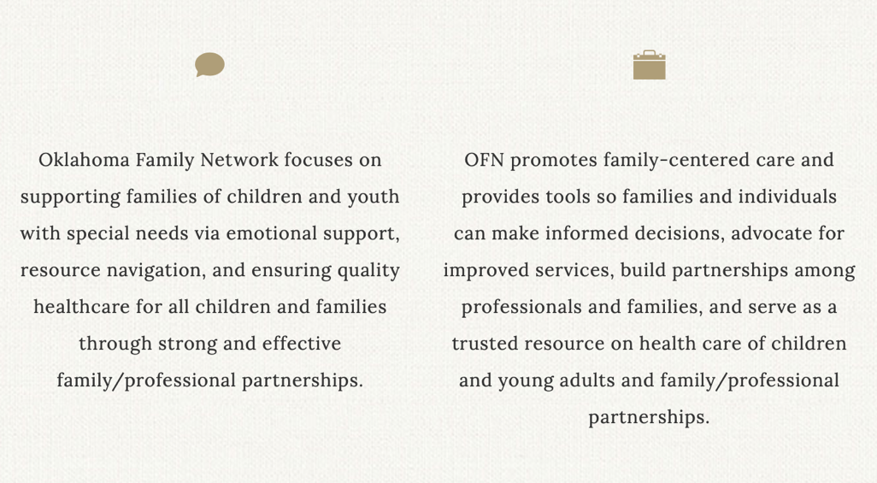

Slide 112
Oklahoma Family Network
Guides families on their journey following the diagnosis of a special healthcare need:
  Resource navigation
  Healthcare system navigation
  Emotional support
Provide trainings to family:
  Follows Parent to Parent USA model
Offer resources to parents:
  Care notebook to help them keep track of appointments
  Joining Forces Training

Slide 113
(1) What happens when someone refers a family to OFN?
Referral form goes to staff office and then is relayed to the appropriate point person
Try to make connection within 24 hours regardless of referral source
Some families only desire resources. An appropriate team member will follow-up with resources

Slide 114
(2) What happens when someone refers a family to OFN?
If they are interested in being matched with a support family, that is the next step
  Follow Parent to Parent USA’s matching protocol
Staff works to find resources in the local community and will work with the family to ensure those connections are made

Slide 115
What You Can Do For Families
Tell families about OFN
Offer to make the call/referral for them
  Many people given a phone number or website won’t reach out themselves

Slide 116
Connect Families: 2 Ways
Fill out the professional referral form on the OFN website
  http://oklahomafamilynetwork.org/professional-referrals/
Contact Tammie Burlison or Renee Powell directly

Slide 117


OFN EHDI Team Contact Information
Renee Powell
Phone: (405) 413-6434
Email: renee-powell@oklahomafamilynetwork.org
Tammie Burlison
Phone: (405) 826-5926
Email: tammie-burlison@oklahomafamilynetwork.org

Slide 118
Summary
Family-centered care is much more than simply wanting what is best for a family, it is a partnership
Audiologists can ease the initial diagnosis of hearing loss by meeting families where they are and showing empathy
Oklahoma Family Network exists as a resource to connect families to other families

Slide 119
Sabrina’s Story
*2-3 minute family story video here*

Slide 120
Part C, Early Intervention, and SoonerStart
What do audiologists need to know?

Slide 121
Highlighted Question from 2018 Survey
Survey question: “What obstacles to do you see in regards to children getting early intervention (EI) services?”
Answers included:
  PCP does not refer
  Parent not interested
  Not sure who has responsibility to refer
  Not sure who qualifies for services

Slide 122
EHDI’s Answers
PCP does not refer: Anyone can refer
  PCP may think you are referring
Parent not interested:
  It is a VOLUNTEER program
  Our role is to educate family on EI
  Offer to make the direct referral – usually they then become interested
  Sometimes it is just so overwhelming to parents/guardians
Not sure whose responsibility is it to refer: Anyone can refer
Not sure who qualifies for services – Unilateral or bilateral hearing loss >25 dB HL is an automatic qualifier

Slide 123
What is Part C – Early Intervention?
Established in 1986- Through a federal grant
Every state has a Part C- Early Intervention Program
Developed to assists states in establishing a comprehensive early intervention program for infants and toddlers with developmental delays and disabilities.
The goal is to work with families to help change the trajectory of the child’s development to reduce the need for Special Education services.
Part C must be available to serve all infants and toddlers that are eligible for the program

Slide 124
(1) Part C in Oklahoma: SoonerStart
1989 under the Oklahoma Early Intervention Act, SoonerStart became a state law
Through an interagency contract, services are provided by the:
  State Department of Education (OSDE)
  State Department of Health (OSDH)
State Department of Education is the lead agency
  Monitoring, receives the state & federal funds and Resource Coordination (case management)
State Department of Health is the service provision agency
  Service providers: OT, PT, SLP, RN, CDS, Psy, SE and contractor providers
  Clerical staff
  The SoonerStart program is housed in county health department. (except our stand alone sites, OK & Tulsa Co)

Slide 125
(2) Part C in Oklahoma: SoonerStart
Population: Infants and toddlers Birth to 3 years old AND THEIR FAMILIES
Parent Education program - give the family the tools they need to support and advocate for their family and child
SoonerStart is a voluntary program
SoonerStart serves all 77 counties in the State

Slide 126
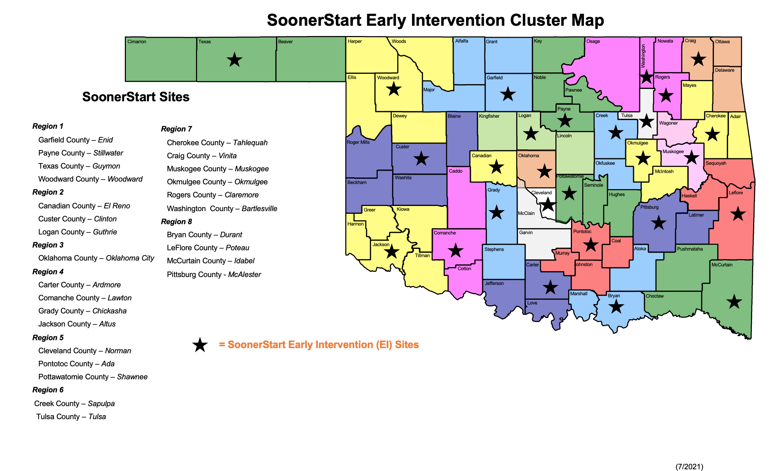

Slide 127
In Oklahoma, there is NO direct cost to families for SoonerStart services.
SoonerStart services are funded through:
Federal, State and SoonerCare funds

Slide 128
Should I be the one to make the referral?

Slide 129
YES!
Who should refer to SoonerStart: Any concerned citizen
Parents
Physicians/Audiologist
Social workers
Childcare providers
DHS workers
Early Head Start staff
Grandparents
Babysitters
Sunday school teachers
SoonerStart providers

Slide 130
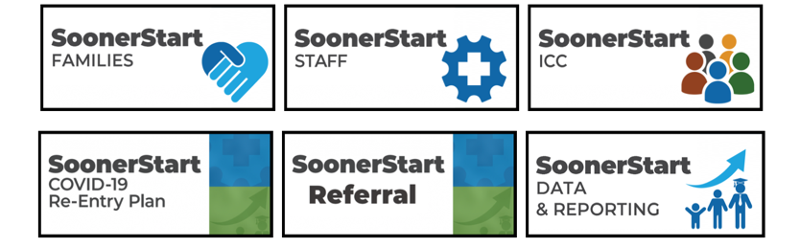
How do I refer to SoonerStart?
Now easier than ever: referral can be done online!
  https://sde.ok.gov/soonerstart
  Call in the referral: 405-521-3575
  Email the referral: SoonerStart@sde.ok.gov

Slide 131
Eligibility:
Infants and toddlers birth to 3 years old who…
Have a developmental delay according to the evaluation process
  Exhibit a delay of 50% or two standard deviations below the mean in one of the stated test areas.
  Exhibit a delay of 25% or one and one-half standard deviation below the mean in two or more stated test areas.
Diagnosed with a physical or mental condition that has a high probability of resulting in a delay –Automatic Qualifiers
  This includes, but not limited to: Autism, Cerebral Palsy, Down Syndrome, chromosomal disorders, hearing and vision impairment.
Evaluation team uses their professional clinical opinion to qualify the child
Definition of developmental delay
Children in this age group that exhibit a delay in their development in the areas of: Cognitive, physical, communication, social and emotional and adaptive development, including subdomains.

Slide 132
(1) I referred a child, What now?
Intake:
  Completed within 10 working days of receiving referral
  Information is gathered and discussed, the Resource Coordinator (RC) will determine if a developmental screening is needed or straight to evaluation. Parents have the option of going straight to evaluation.
Developmental Screening:
  The Battelle Developmental Inventory III will be the instrument used for future evaluations. During the COVID-19 pandemic the Developmental Profile-3 was utilized for virtual evaluation, testing: Motor, Adaptive, Communication, Personal Social and Cognitive development. A second test is administered in the area of concern.

Slide 133
(2) I referred a child, What now?
Qualification is determined:
  If the child does not qualify for SoonerStart services, other community services are discussed and recommended (e.g. Child Guidance program). If the child qualifies, information is shared with staff and it is decided who would be the best fit or most appropriate to serve the child and family’s developmental needs.
Oklahoma Family Interview (OFI)/Individualized Family Service Plan (IFSP):
  The OFI is discussed with families to help get an understanding of the family and child’s needs to get to the core outcomes.
  The IFSP is written as a living document or contract between the family and the program outlining exactly what the core needs or outcomes the family wants to work on - service delivery times are determined. The IFSP team is the FAMILY, Resource Coordinator, Service Provider and anyone else the family would like to invite.

Slide 134
Mandated Timelines
10 working days from the date of the referral SoonerStart must make contact with the family
45 working days from the date of the confirmed referral by the parent/caregiver to the development of the Individualized Family Service Plan (IFSP) for a child who qualifies for services
15 working days from the IFSP, the first intervention visit must take place

Slide 135
What do services look like?
Services are providing the in the child’s natural environment -home, child care etc.
The family will choose their own goals and outcomes to work on. The IFSP is not an IEP, the F stands for FAMILY
Service Providers will model, teach and coach the family with ideas and techniques they can do everyday, during the child’s regular routines to help stimulate the child’s development.
Growth happens in between visits because the family is the child’s #1 teacher

Slide 136
Transition
A Transition Plan is to facilitate a smooth transition by the child’s third birthday
When:
Transition begins between 27 months and 33 months of age.
If a child is referred at or after 33 months, the child receives transition services only.
Where:
Public Schools: Part B (Special Education Services)
Head Start
Child Guidance
Child Care
Preschool programs
Private Services

Slide 137
What can I tell families about SoonerStart?
SoonerStart serves infants and toddlers, birth to three with developmental delays and disabilities
There is NO COST to families for services
Services are in the child’s natural environment
You decide what is important to work on for you and your family
SoonerStart exist to be a support system and not a burden
SoonerStart is a voluntary program
Most importantly: If you’d like, I can refer your child to SoonerStart

Slide 138
Summary
Where to refer- SoonerStart Early Intervention and private services
How to refer:
  Online: https://sde.ok/gov/soonerstart
  Call: 405-521-3575
  Email: SoonerStart@sde.ok.gov
When to refer- immediately
Who to refer- all children with hearing loss and or concerns regarding overall development/communication
For more information, SoonerStart Referral Guide is available here: https://soonersuccess.ouhsc.edu/Portals/1024/Combined%20Sooner%20Start.pdf

Slide 139
Hollie’s Story
*2-3 minute family story video here*

Slide 140

Acknowledgement
Oklahoma LEND
Maternal and Child Health Bureau
Grant T73MC00033
Health Resources and Services Administration
U.S. Department of Health and Human Services
This project was supported by the Health Resources and Services Administration (HRSA) of the U.S. Department of Health and Human Services (HHS) under grant number T73MC00033 for Oklahoma LEND This information or content and conclusions are those of the author and should not be construed as the official position or policy of, nor should any endorsements be inferred by HRSA, HHS or the U.S. Government.

Slide 141

Q & A

Slide 142
(1) References
(2019). Year 2019 Position Statement: Principles and Guidelines for Early Hearing Detection and Intervention Programs. Journal of Early Hearing Detection and Intervention, 4(2), 1-44. DOI: 10.15142/fptk-b748 Retrieved from https://digitalcommons.usu.edu/jehdi/vol4/iss2/1
American Academy of Audiology. (2013). American Academy of Audiology Clinical Practice Guidelines: Pediatric Amplification. Avaliable from https://www.audiology.org/practice-resources/practice-guidelines-and-standards/.
American Academy of Audiology. (2019). Code of Ethics for the American Academy of Audiology. Available from https://www.audiology.org/clinical-resources/code-of-ethics/.
American Speech-Language-Hearing Association. (2006). Roles, knowledge, and skills: audiologists providing clinical services to infants and young children birth to 5 years of age [Knowledge and Skills]. Available from www.asha.org/policy.
American Speech-Language-Hearing Association. (2016). Code of ethics [Ethics]. Available from www.asha.org/policy/.

Slide 143
(2) References
Fran D. Goldfarb, KimLori Devine, Jacalyn T. Yingling, Antoinette Hill, Jan Moss, Elaine Shurie Ogburn, Ruth J. Roberts, Mark A. Smith & Crystal Pariseau (2010) Partnering With Professionals: Family-Centered Care From the Parent Perspective, Journal of Family Social Work, 13:2, 91-99, DOI: 10.1080/10522150903487081
Institute for Patient- and Family-Centered Care. Available at: https://www.ipfcc.org/about/pfcc.html Accessed March 23, 2021.
Okla. Admin. Code § 310:540-1-3
S.652 - 115th Congress (2017-2018): Early Hearing Detection and Intervention Act of 2017, S.652, 115th Cong. (2017), https://www.congress.gov/bill/115th-congress/senate-bill/652.

